Slide 1
Recent Progress in Open Heavy-Flavor Studies at RHIC and Future Prospects at RHIC and LHC
Stephen Baumgart
RIKEN

Slide 2
Outline
A) Motivation
B) Past Measurements of Heavy Flavor in RHIC Experiments
1) Hadronic measurements of charm
2) Semi-Leptonic measurement of heavy flavor
3) Angular charm/bottom separation analysis
C) Future Upgrades and Analyses
1) STAR-HFT
2) PHENIX-VTX
3) ALICE

Slide 3
A) Motivation

Slide 4
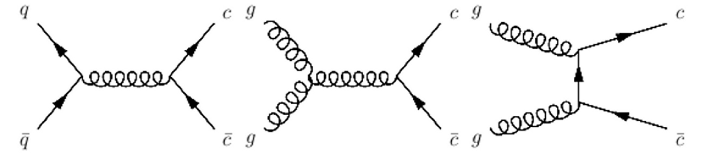
Charm as a Probe of the Medium
Gluon fusion predicted to be dominant process at collision energies of 200 GeV/nucleon.
Sum of Feynman diagrams can be evaluated to find open charm cross-section.
Is open charm produced during the initial stages of the collision or is some generated later? (Binary Scaling)
Does the open charm cross-section measured at 200 GeV/nucleon match the predictions of QCD?

Slide 5
Prediction of Open Charm Cross-Section using Perturbative Quantum Chromodynamics (pQCD)
Method 1:
use dp_{t} slices, then integrate final result
treat charm as active flavor
FONLL Calculation
Charm Cross Section Predicted for 200 GeV Collisions:
Method 2:
calculate on full p_{t} range in one step
treat charm as NOT an active flavor (heavy quark considered massive)
NLO Calculation
Charm Cross Section Predicted for 200 GeV Collisions:
Ref: R. Vogt, arXiv:0709.2531v1 [hep-ph]
Experiment can help constrain these theoretical predictions.

Slide 6
Prediction of Open Beauty Cross-Section
Prediction from pQCD
Low cross-section makes measurement difficult at RHIC energies

Slide 7
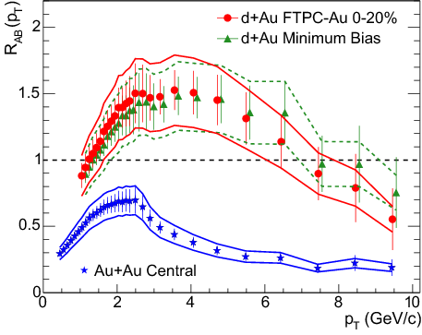

Nuclear Modification Factor
Measures effect of nuclear medium on quarks.
Light quark experience strong suppression at high p_{t} due to medium induced gluon radiation
Heavier quarks were expected to have less RAA suppression due to the dead-cone effect from their large mass, but this turned out not to be the case.
STAR light mesons

Slide 8
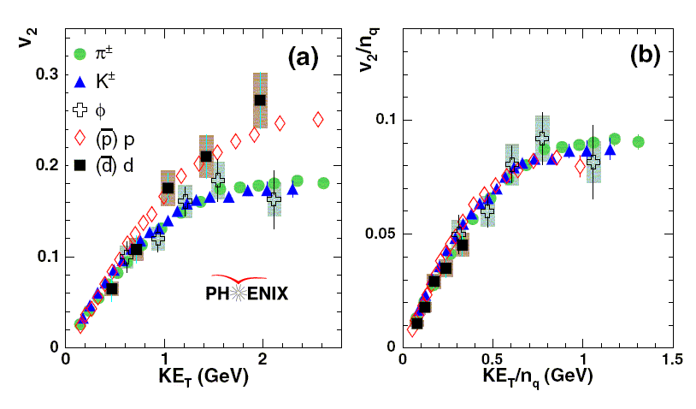
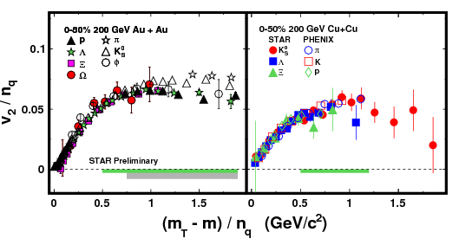

Collective Flow Effects
From S. Shi, arXiv:0907.2265
Quark scaling a signature of the QGP, as it shows quarks are deconfined
If heavy quarks flow, they are interacting with the lighter quarks within the nuclear fireball (thermalized)

Slide 9
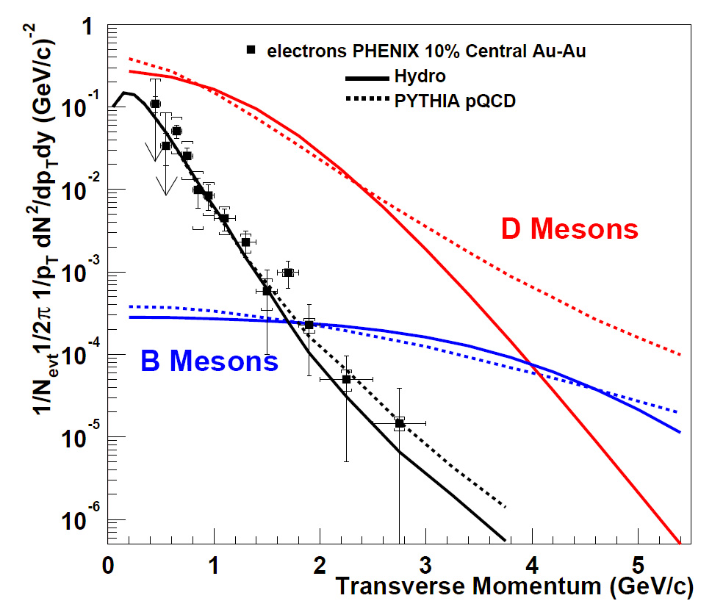
Charm/Beauty Separation
Pythia and Hydro predictions for Charm/Beauty ratio contradict each other.
Therefore, a measurement of this ratio would help define models.
S. Batsouli et al., Phys. Lett. B 557 (2003) 26

Slide 10
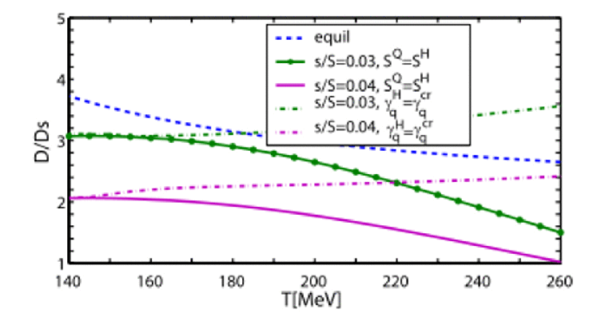
Statistical Hadronization Model
RHIC
Prediction of particle yields based on thermalized, deconfined plasma.
D_{inc}/D_{s} ratio predicted to be ~2.8 at RHIC according to SHM. Compare with Pythia prediction of ~7.3 or e⁺e⁻ collision data of ~4.8
Is the D_{inc}/D_{s} measured in 200 GeV/nucleon Au+Au collisions consistent with the predictions for a thermalized QGP?

Slide 11
B) Past Measurements of Heavy Flavor in RHIC Experiments
STAR and PHENIX had made extensive heavy measurements at square-root-of-S_{NN} = 200 GeV
PHENIX had made semi-leptonic measurements of heavy flavor decays while STAR has undertaken both full reconstruction of open charm decays and semi-leptonic measurements.

Slide 12
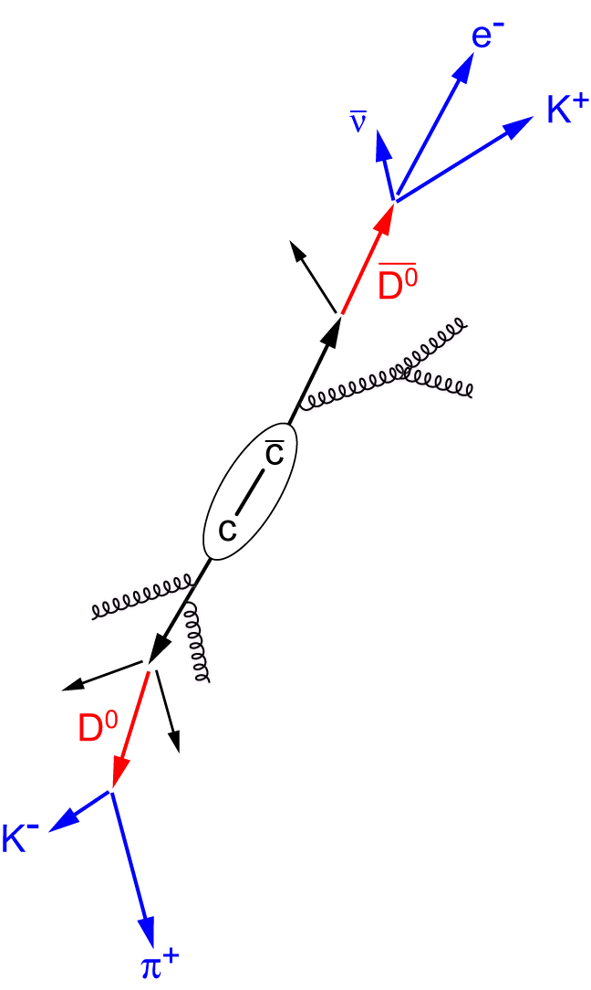
Geometry of Heavy Flavor Decays
Semi-Leptonic Decay
Electron
Secondary Decay Vertex
Decay Vertex
D or B Meson
Distance-of-Closest
Approach (DCA)
Primary Vertex
Particle Type | Mass (MeV) | cτ (μm)
D⁰ | 1864.84 +/- 0.17 | 122.9
D^{+/-} | 1869.62 +/- 0.20 | 311.8
D_{s} | 1968.49 +/- 0.34 | 149.9
B^{+/-} | 5279.17 +/- 0.29 | 491.1
B⁰ | 5279.50 +/- 0.30 | 457.2
B_{s} | 5366.3 +/- 0.6 | 441
Primary Vertex
Decay Vertex
Hadronic Decay Example

Slide 13
Hadronic Measurements of Open Charm in the STAR Experiment

Slide 14
STAR Hadronic Reconstructions of Open Charm
D⁰s reconstructed through the Kπ decay channel in d+Au, Cu+Cu, and Au+Au collisions at a CM beam energy of 200 GeV per nucleon.
The STAR-SVT has been used to help geometrically reconstruct all three of the open charm mesons, D, D⁰, and D_{s}. Primary tracks are cut out using DCA and secondary vertex cuts.

Slide 15
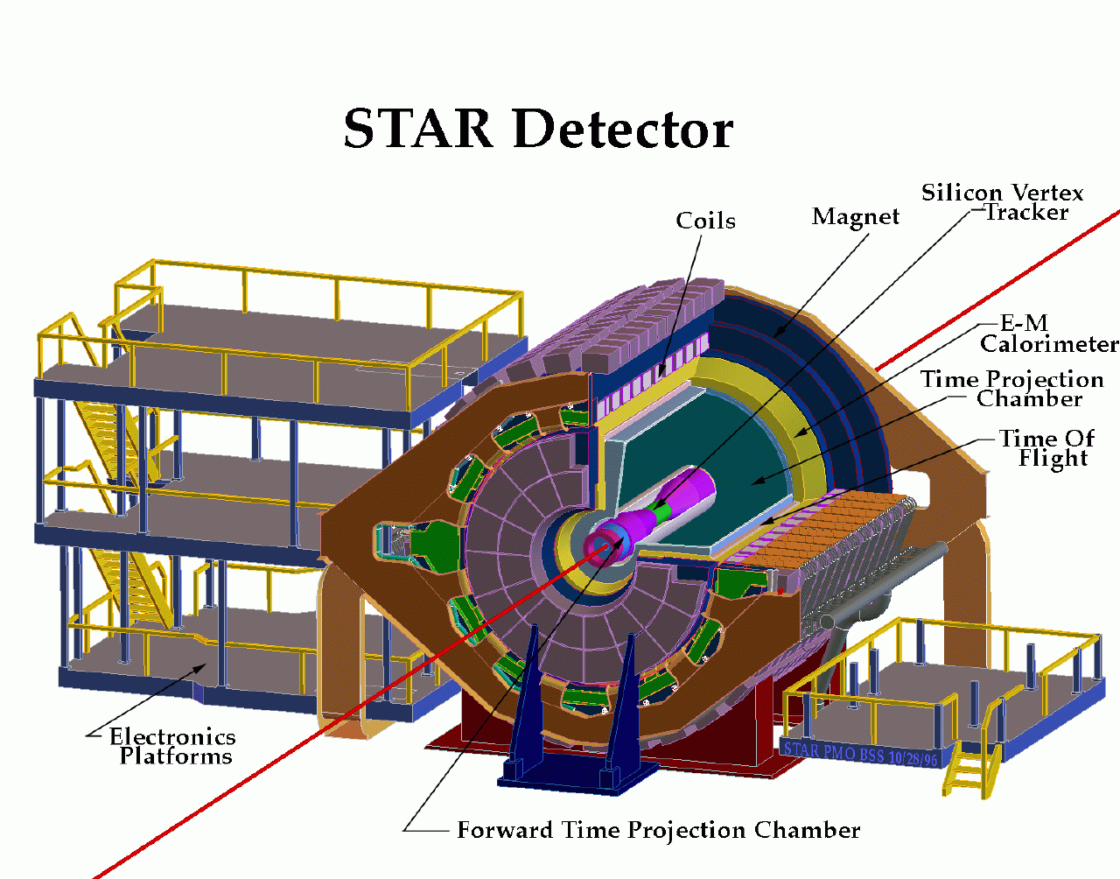
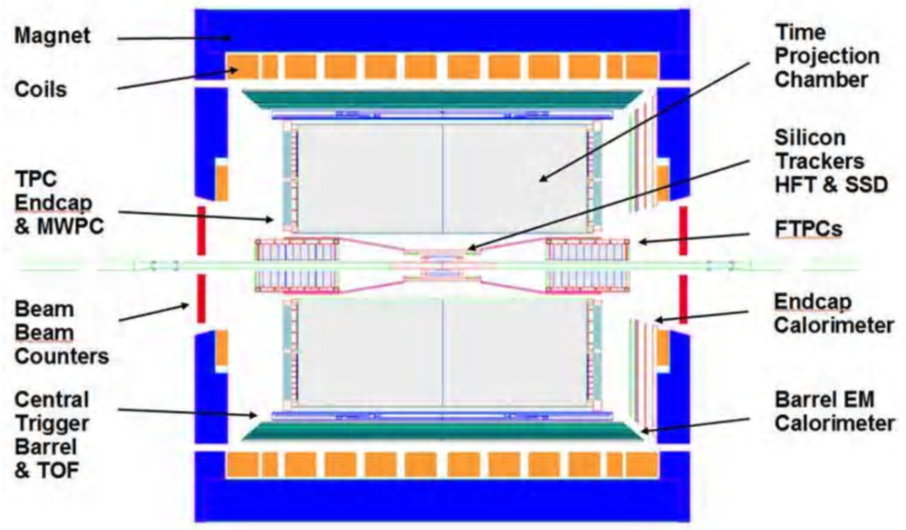
Solenoidal Tracker at RHIC (STAR)
Full Azimuthal Coverage
Primary detector is the TPC
Coverage of |y| < 1.0 using TPC
Magnetic Field of +/- 0.5 Tesla inside solenoidal magnet

Slide 16
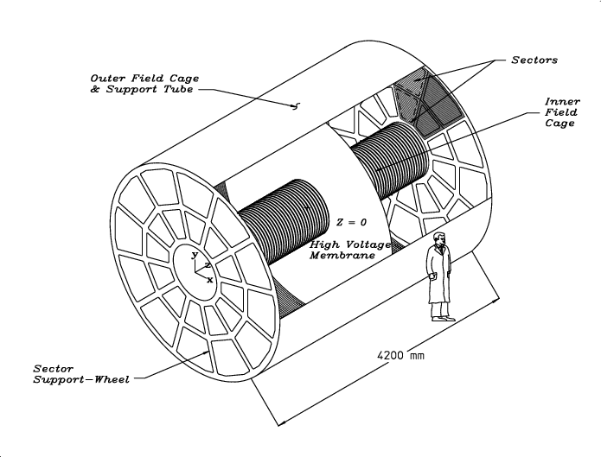
The Time Projection Chamber (TPC)
Measures dE/dx and Momentum of particles
Filled with P10 gas which is ionized by particles
Electrons drift to read-outs at ends of detector.
Length = 4.2 m, Inner diameter = 1 m, Outer diameter = 4 m.

Slide 17
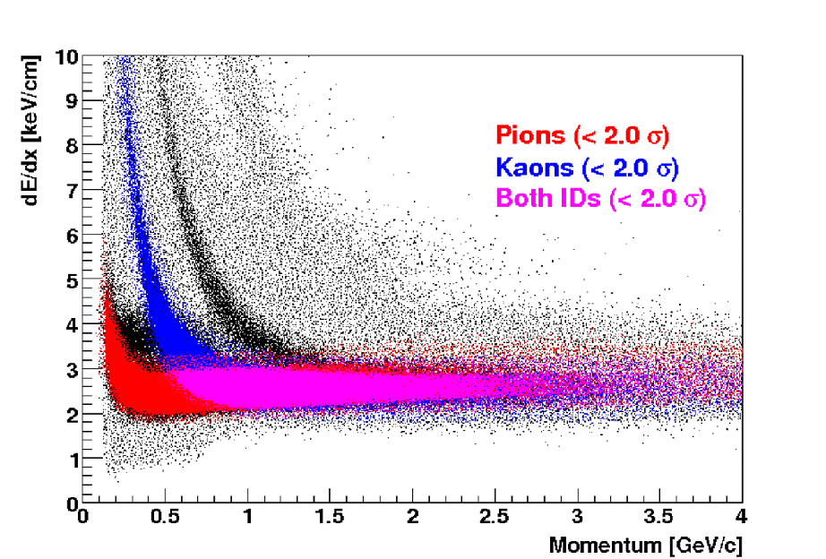
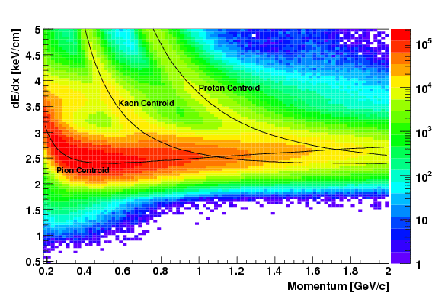
STAR Particle Identification
dE/dx and momentum used with Bichsel Parameterization to do Particle Identification (PID).

Slide 18
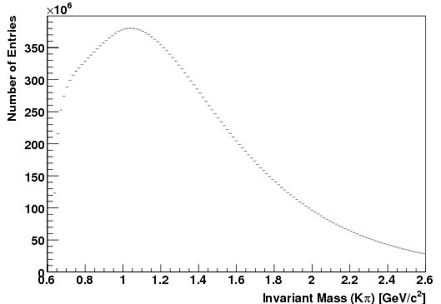
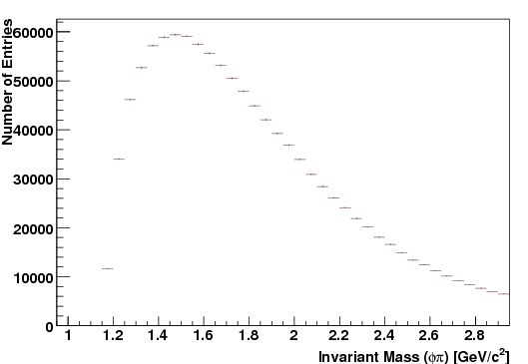
Invariant Mass Spectra Before Background Subtraction
200 GeV Cu+Cu
πK combinations
200 GeV Au+Au
Φπ combinations
No signals are visible before background subtraction.

Slide 19
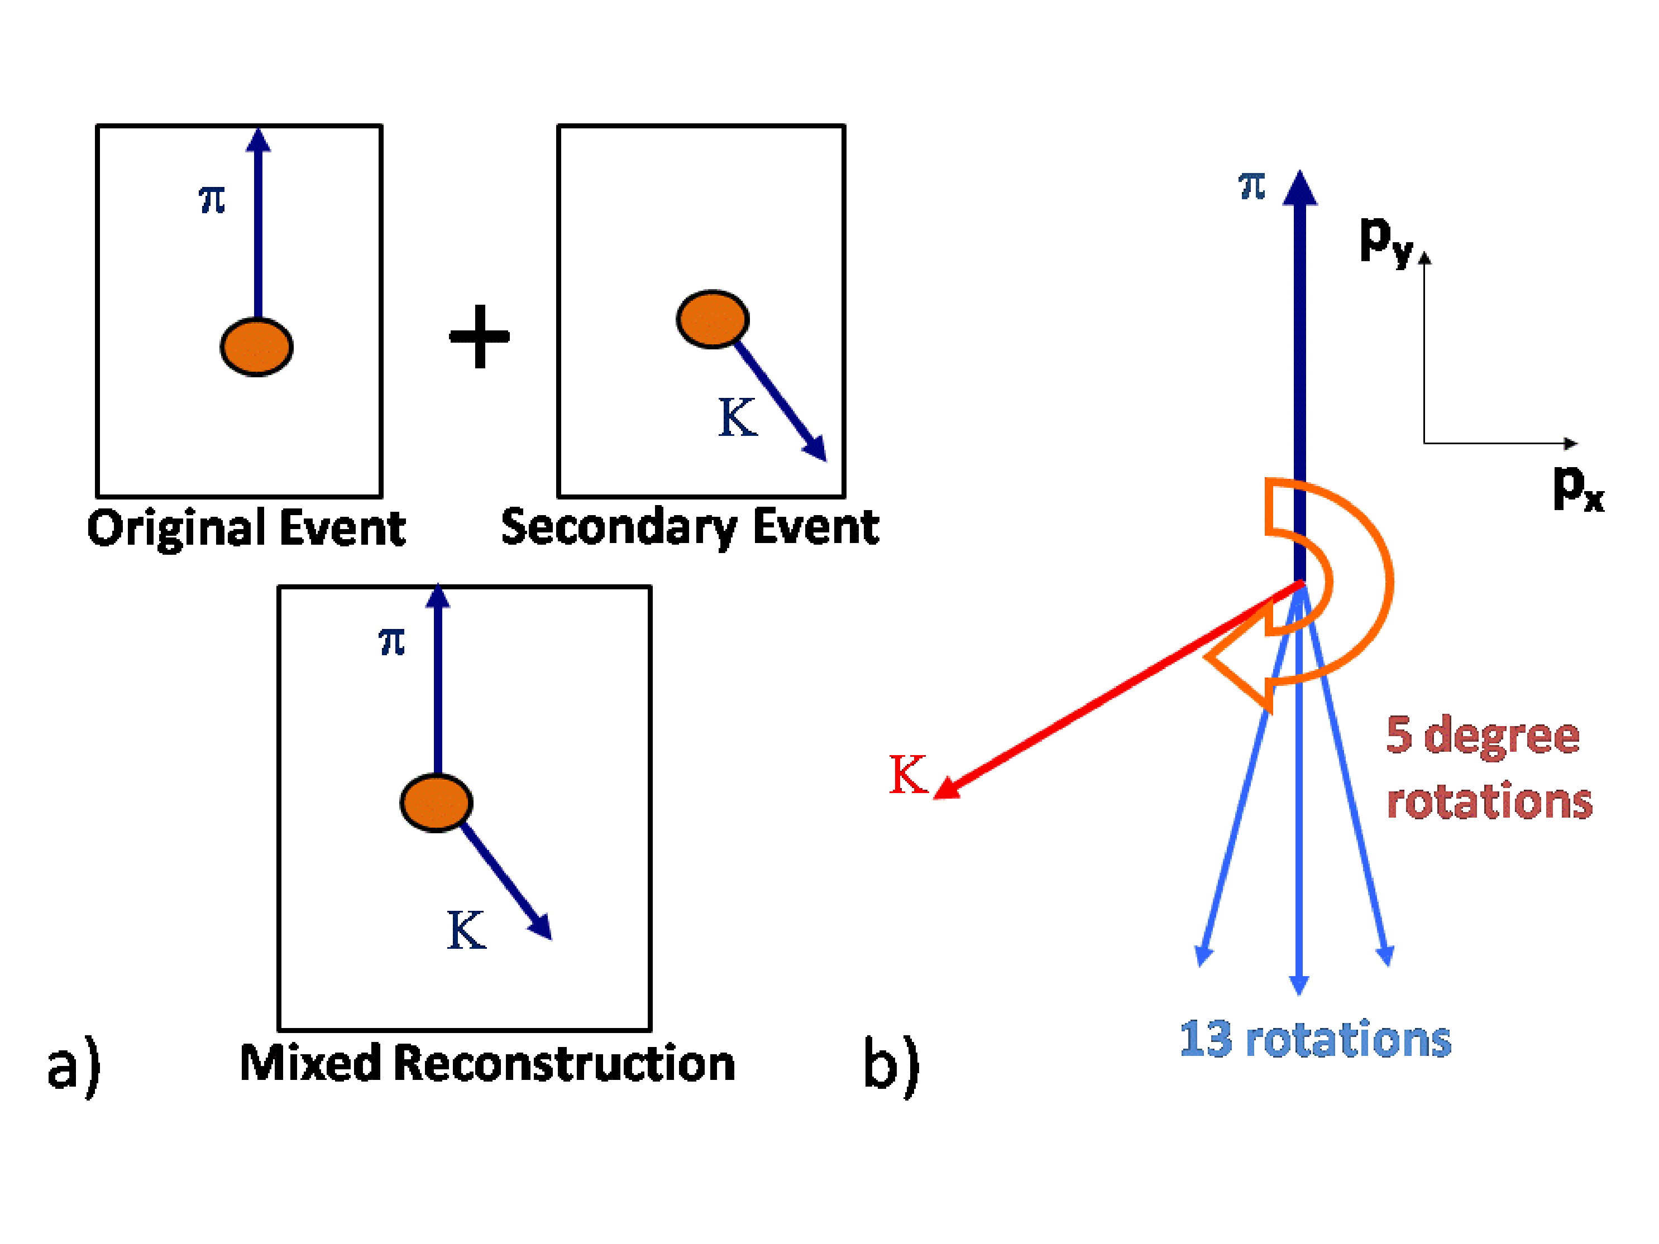
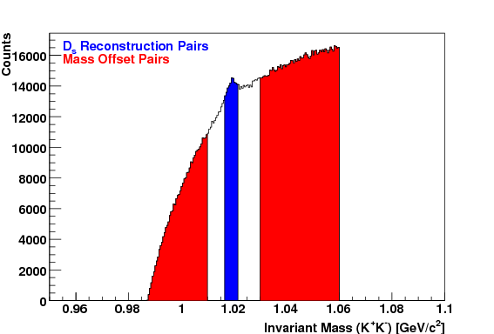
Background Subtraction
Event Mixing (D⁰)
Rotation (D⁰, D_{s})
Mass Offset Background (D_{s})
Rotational background subtraction done every 5 degrees between 150 and 210 degrees.
Event mixing done in D⁰ analysis.
Offset Background Subtraction done in D_{s} analysis using K⁺K⁻ pairs.

Slide 20
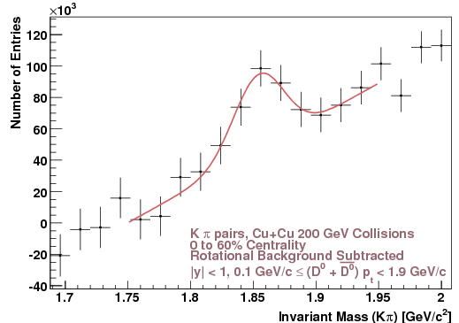
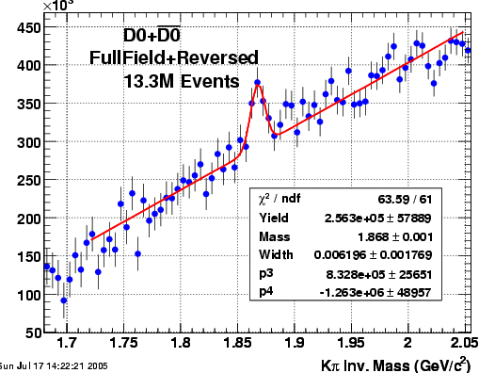
Direct Reconstruction Of D⁰ mesons in STAR
Direct Invariant Mass Reconstruction From Kπ track candidate pairs.
Background subtraction necessary to find signal
Residual shape appears udner signal.
200 GeV Au+Au
200 GeV Cu+Cu

Slide 21
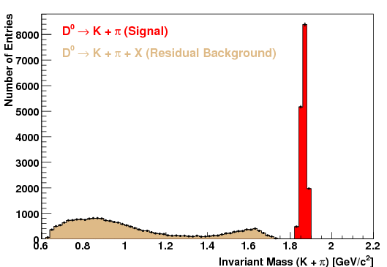
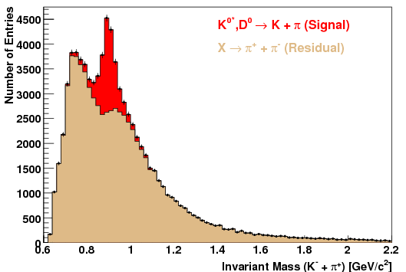
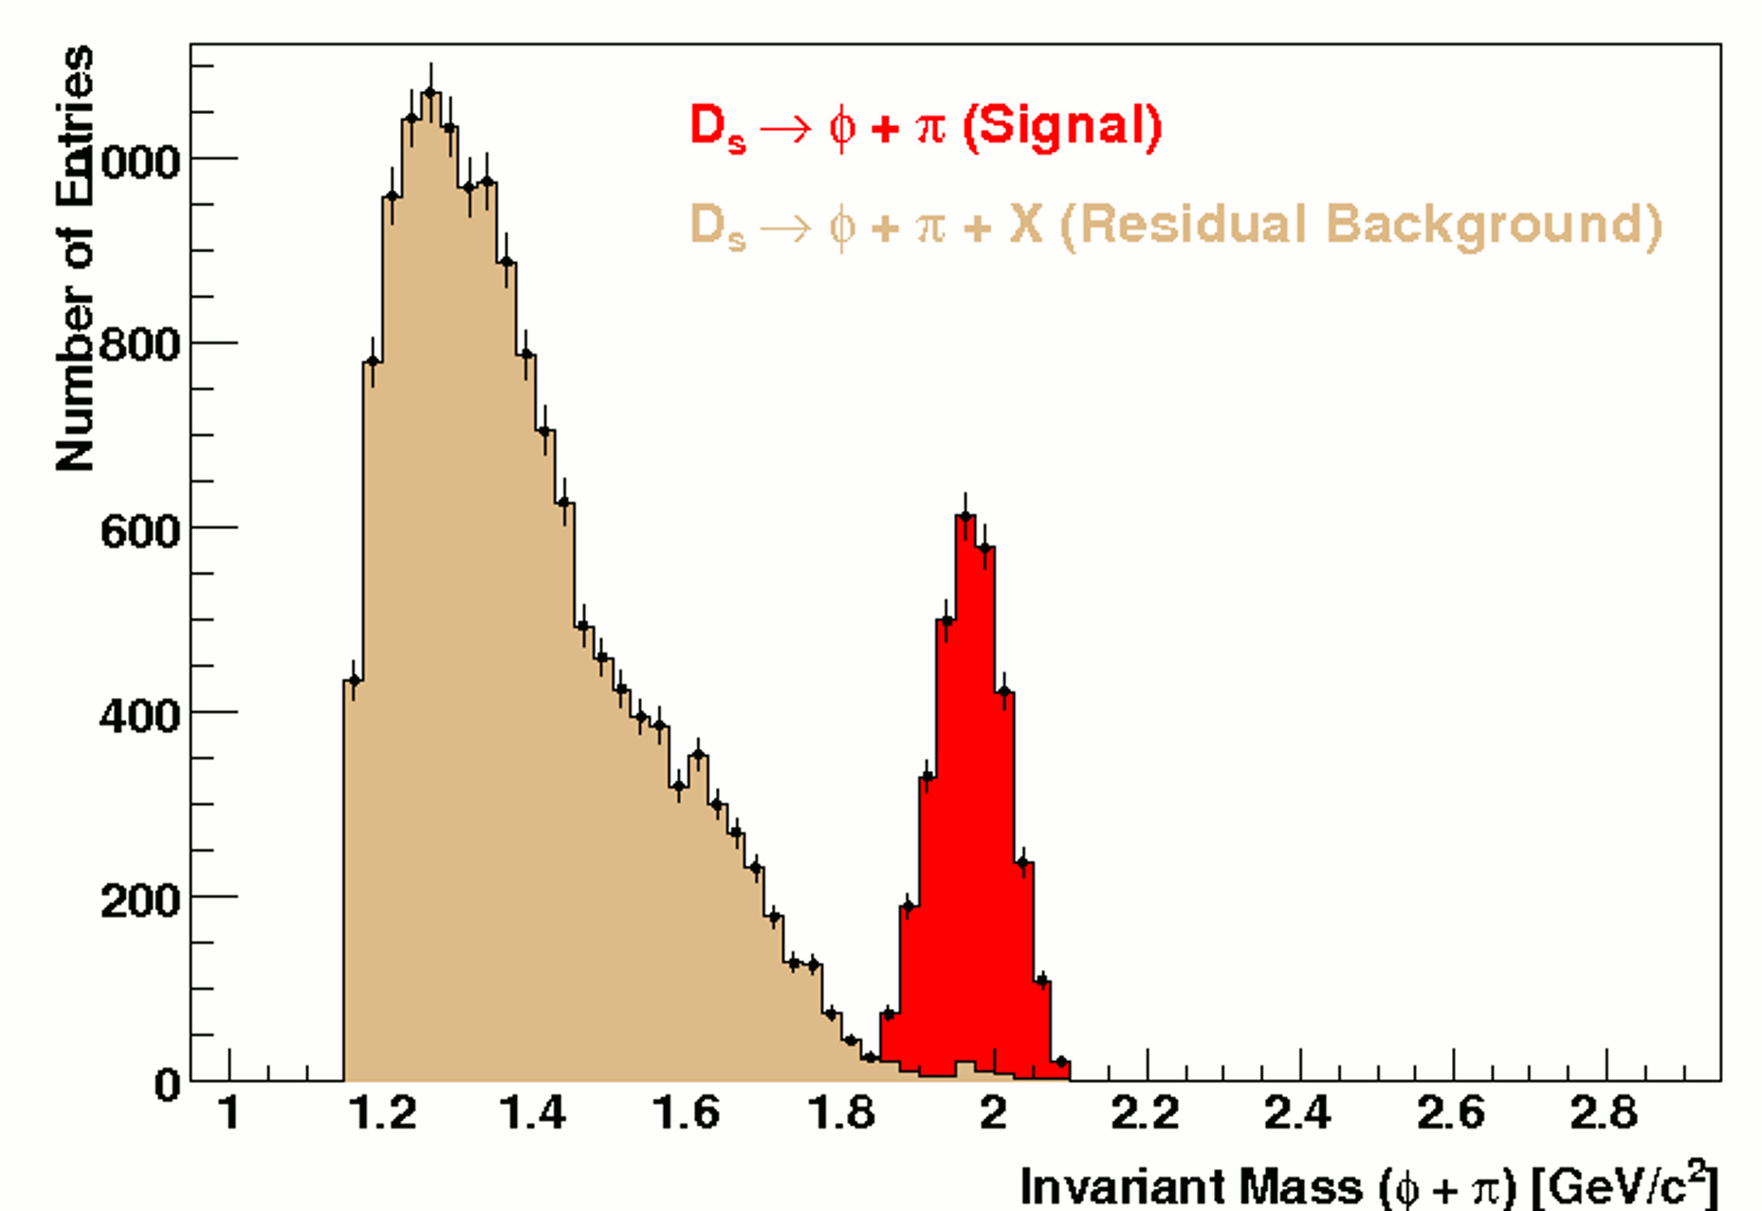
Simulation of Residuals
Simulations show that resonances with misidentified daughters and other decay channels are major contributors to residual background.

Slide 22
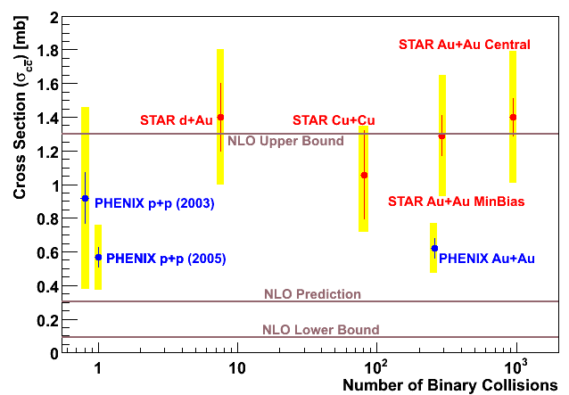
Open Charm Cross-Section and the STAR-PHENIX Contraction (as of last year)
STAR total charm cross-sections dominated by hadronic channel, PHENIX by semi-leptonic.
STAR and PHENIX results internally consistent with binary scaling of open charm.
STAR and PHENIX measured the total charm cross-section to be greater than pQCD predictions but the STAR measurement contradicted PHENIX’s by a factor of two.

Slide 23
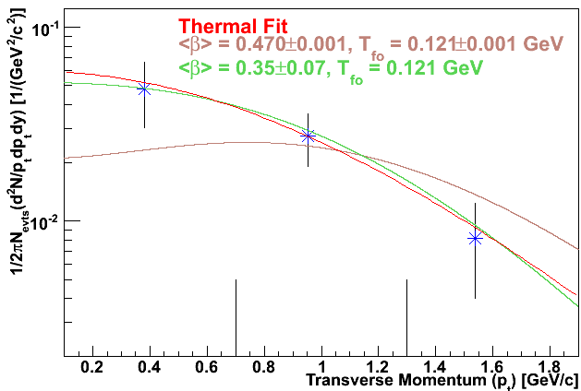
Radial Flow of D⁰ (Cu+Cu 200 GeV)
D⁰ yield datapoints
Light meson parameters and curve
STAR results indicate that D⁰s do not flow with lighter mesons (pions and kaons) after chemical freeze-out; therefore, they are not strongly coupled.

Slide 24
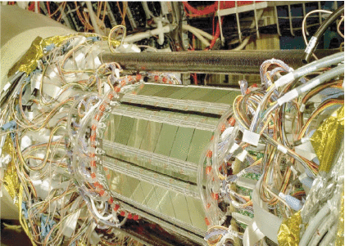
STAR Silicon Vertex Detector (SVT)
Inner silicon tracker used to help reconstruct open charm decays geometrically.
Interior to the TPC
Three barrels of radii 6.9, 10.8, and 14.5 cm, lengths 25.2, 37.8, and 44.4 cm.

Slide 25
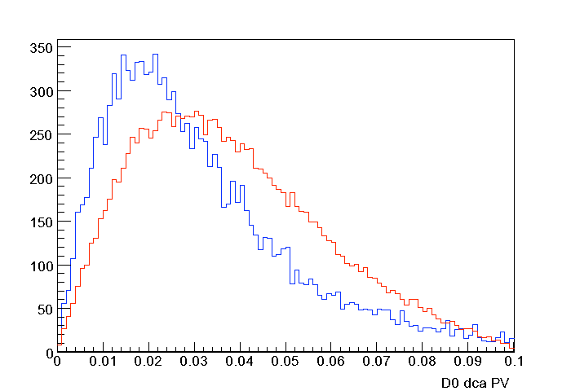
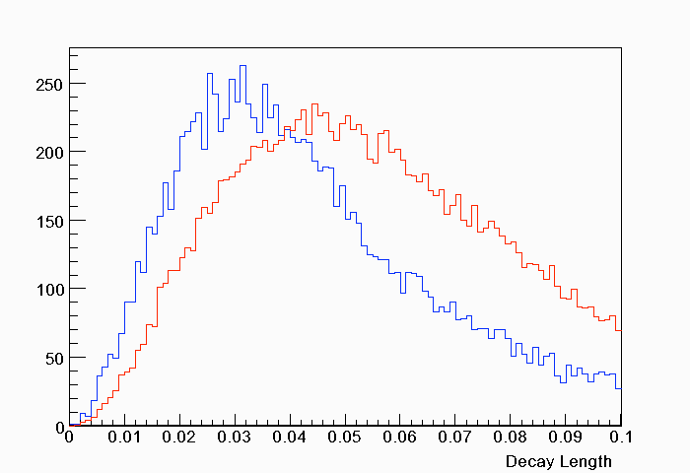
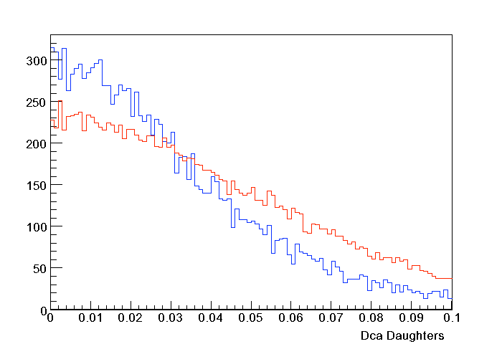
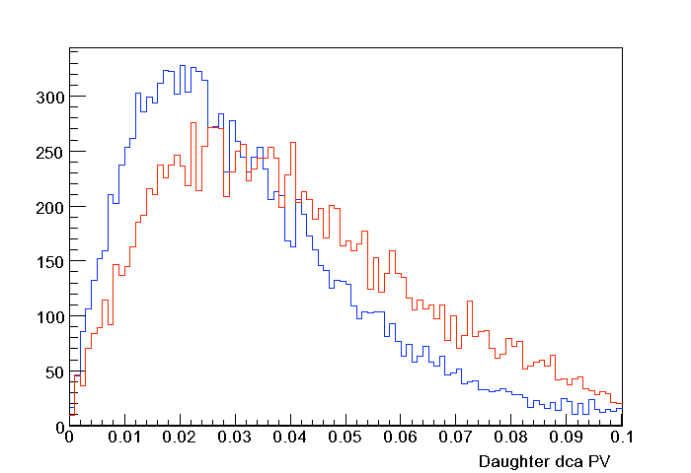
STAR Topological Reconstructions of Open Charm using the STAR-SVT
D⁰ DCA to
Primary Vertex
Decay Length
Key:
Pythia D⁰
AuAu Background
Pythia shows different shapes of D⁰ signal and background.
DCA between
daughters
Daughter DCA
to primary vertex
Sarah LaPointe, QM 09 Presentation

Slide 26
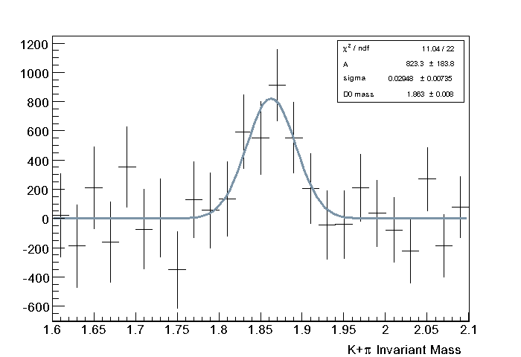
D⁰ Reconstruction using STAR-SVT in 200 GeV Au+Au Collisions
Sarah LaPointe, QM 09
Presentation
Statistical significance of 4.5 σ but efficiency calculations still in progress.
Shows potential of inner silicon tracking in heavy-ion collisions (since no signal observable without use of silicon tracking)

Slide 27
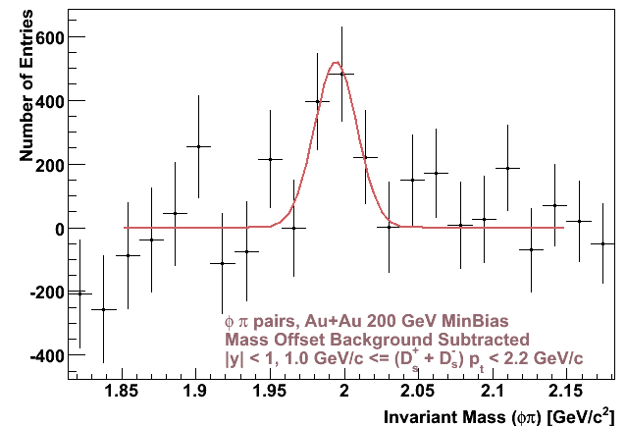
D_{s} (Charm-Strange Reconstruction) in 200 GeV Au+Au Collisions
From S. Baumgart,
Dissertation Thesis
Weak signal reconstructed from φπ decay channel using STAR-SVT and TPC.
Cuts on DCA and decay length reduce background.

Slide 28
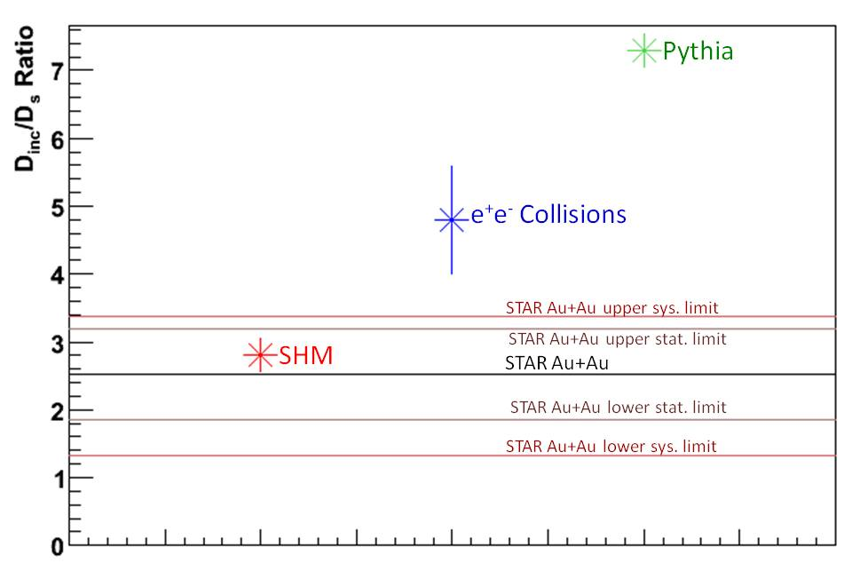
D_{s} Results in Au+Au Collisions (STAR)
Preliminary results show D_{s} enhancement in AuAu collisions over simulation and e⁺e⁻ results, as predicted by the statistical hadronization model in the presence of a QGP.
STAR and ALICE plan further D_{s} analyses.

Slide 29
Semi-Leptonic Measurements and Results

Slide 30
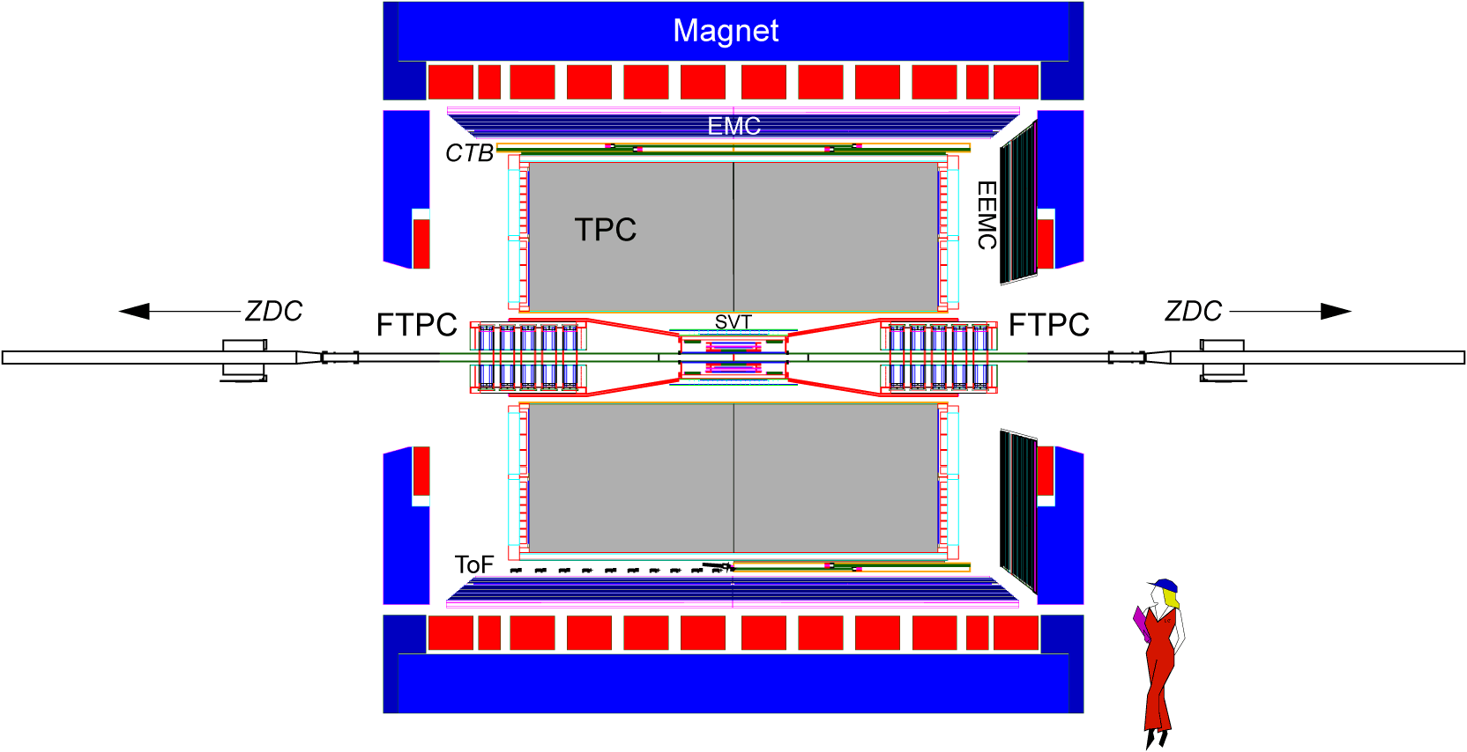
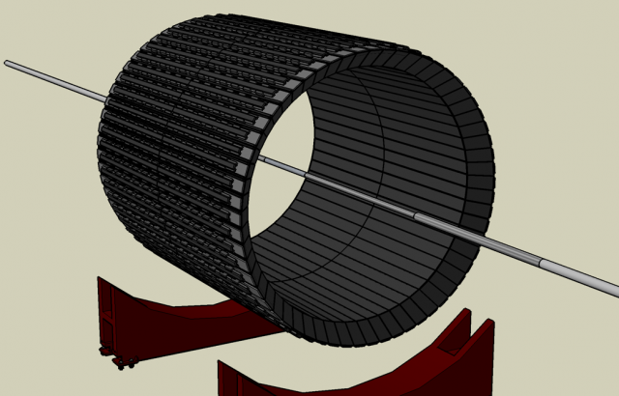
STAR Electromagnetic Calorimetry
Energy measurement for E/p cut to assist in electron identification
Require electrons to have E/p ~ 1
STAR BEMC

Slide 31
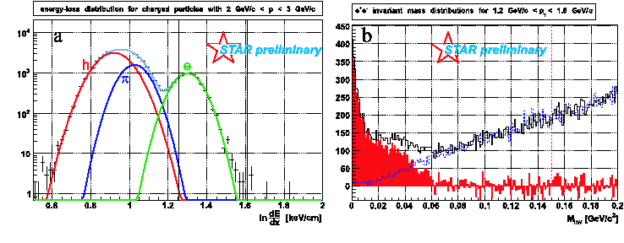
STAR Semi-Leptonic Measurement
STAR uses the Electro-magnetic Calorimeter (for a E/p cut) and the TPC (for momentum measurement) to measure the yield of electrons.
Photonic conversions are cut out using a cut on invariant mass of electron pairs.

Slide 32
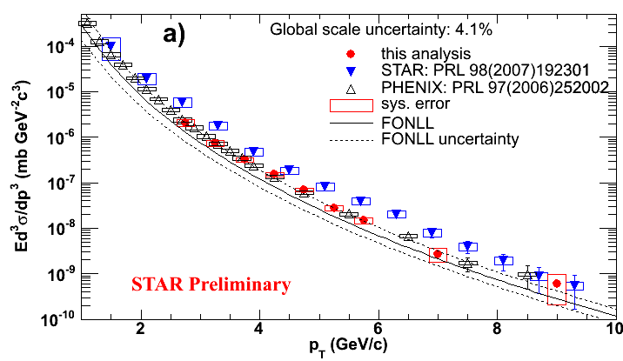
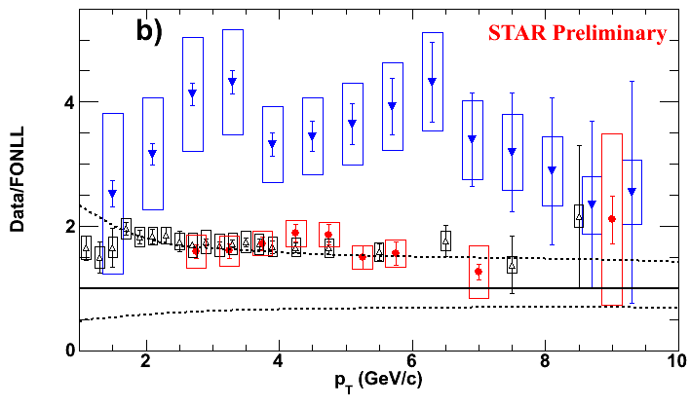
STAR and PHENIX charm yields derived from electron measurements
Near upper limit of FONLL prediction for charm-cross section.
Latest STAR measurements consistent with PHENIX but not with older STAR results (?!)
Older STAR results may suffer from background due to conversions within SVT detector.

Slide 33
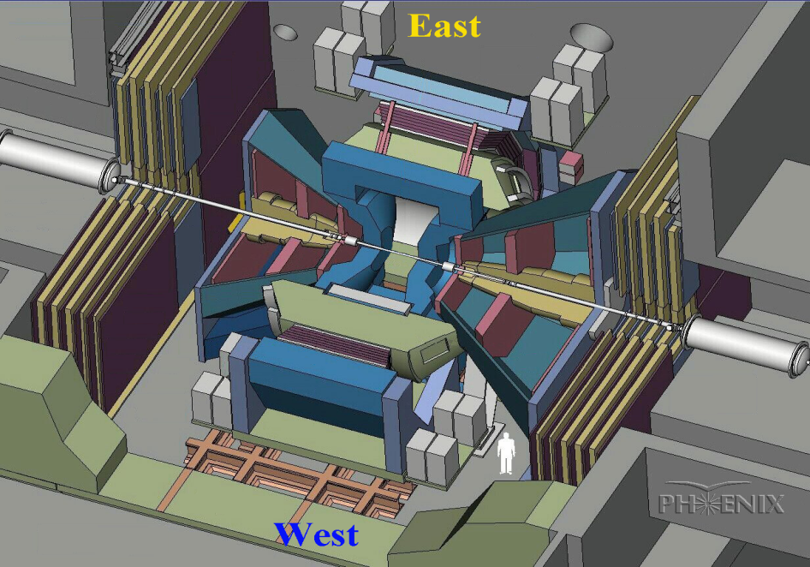
The PHENIX Experiment
Unlike STAR, more specialized for rarer events.
Muon arms in direction parallel to beam line.
Central arms perpendicular to beam line allow particle identification.

Slide 34
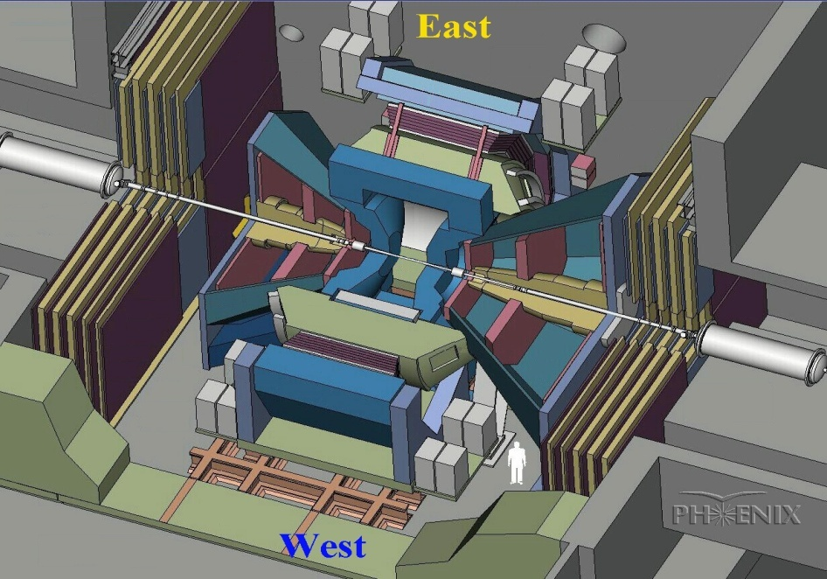
Measuring Heavy Flavor via Single Electrons in PHENIX
Electrons measured in central spectrometer arms (identification by electro-magnetic calorimeter and ring imaging Cerenkov detectors).
Secondary vertex to be located by
inner silicon VTX detector (future)
e⁻
Charm or beauty is created early in the evolution of the Quark Gluon Plasma, generally from gluon fusion.
Direct hadronic reconstruction being evaluated in my current STAR analysis.
The PHENIX Detector

Slide 35
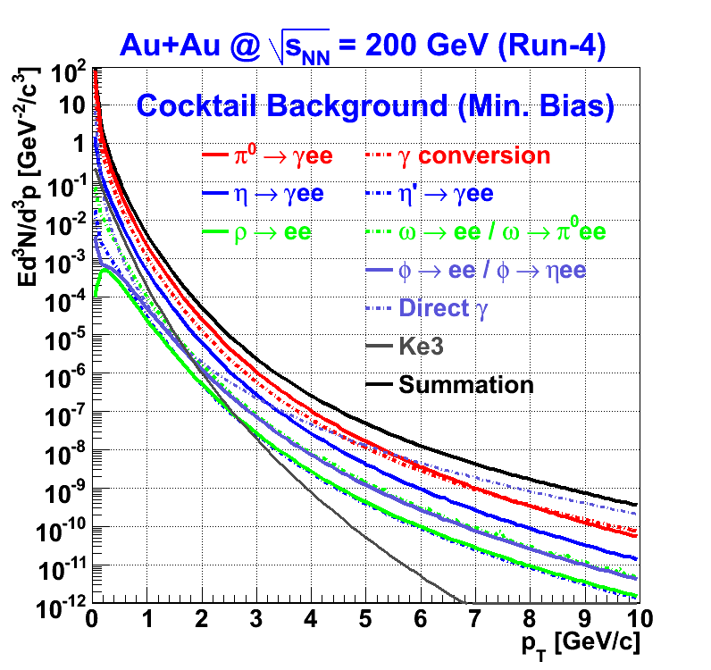
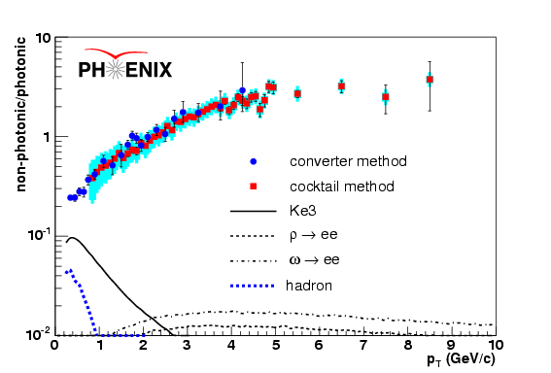
Two Methods to Evaluate Single Electron Background
N_{e Electron yield}
converter
Photonic Electron Background is a serious problem.
0.8%
0.4%
1.7%
Converter Method:
A brass cylinder of known radiation length is used to find the background from photon conversions (low systematic error, high statistical error).
Cocktail Method:
All known sources of electrons are calculated and added together (high systematic error, low statistical error).
With converter
Photonic
W/O converter
Dalitz : 0.8% X₀ equivalent radiation length
Non-photonic
0
Material amounts: Χ₀
from F. Kajihara’s INPC07 Presentation
The Two Methods Agree With Each Other!
from F. Kajihara’s INPC07 Presentation
Phys.Rev.Lett. 97 (2006) 252002

Slide 36
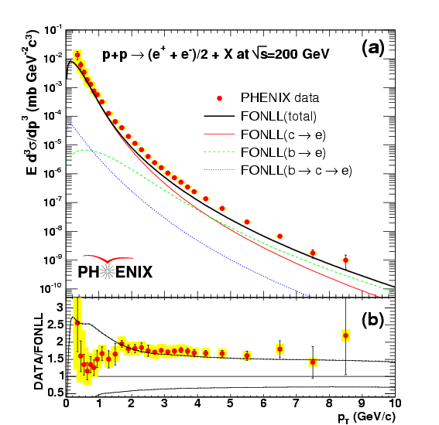
PHENIX Heavy Flavor to Semi-leptonic Decays in p+p Collisions
Consistent with FONLL Predictions

Slide 37
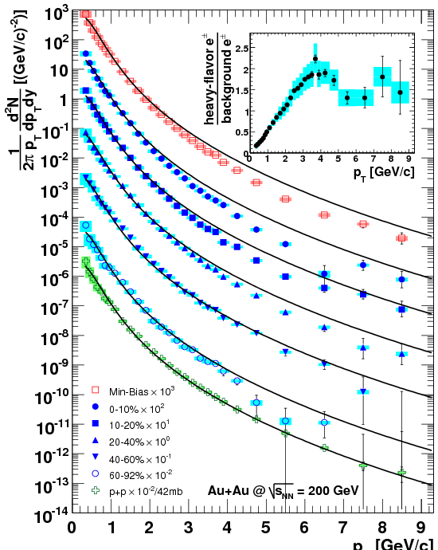
PHENIX Semi-Leptonic Results
PHENIX has measured high pt electron spectra in p+p and Au+Au collisions at square-root of SNN = 200 GeV
Shows binary scaling of open charm
This allows R_{AA} to be extracted.
Simulation shows that almost all electrons after background subtraction in this pt range are from heavy flavor.

Slide 38
Comments on Latest STAR Electron Results
New STAR open charm cross-section in d+Au collisions based on semi-leptonic decays is a factor of two lower than previous measurements.
This may solve the STAR/PHENIX discrepancy for charm cross-section but mesonic sector discrepancy may still exist.

Slide 39
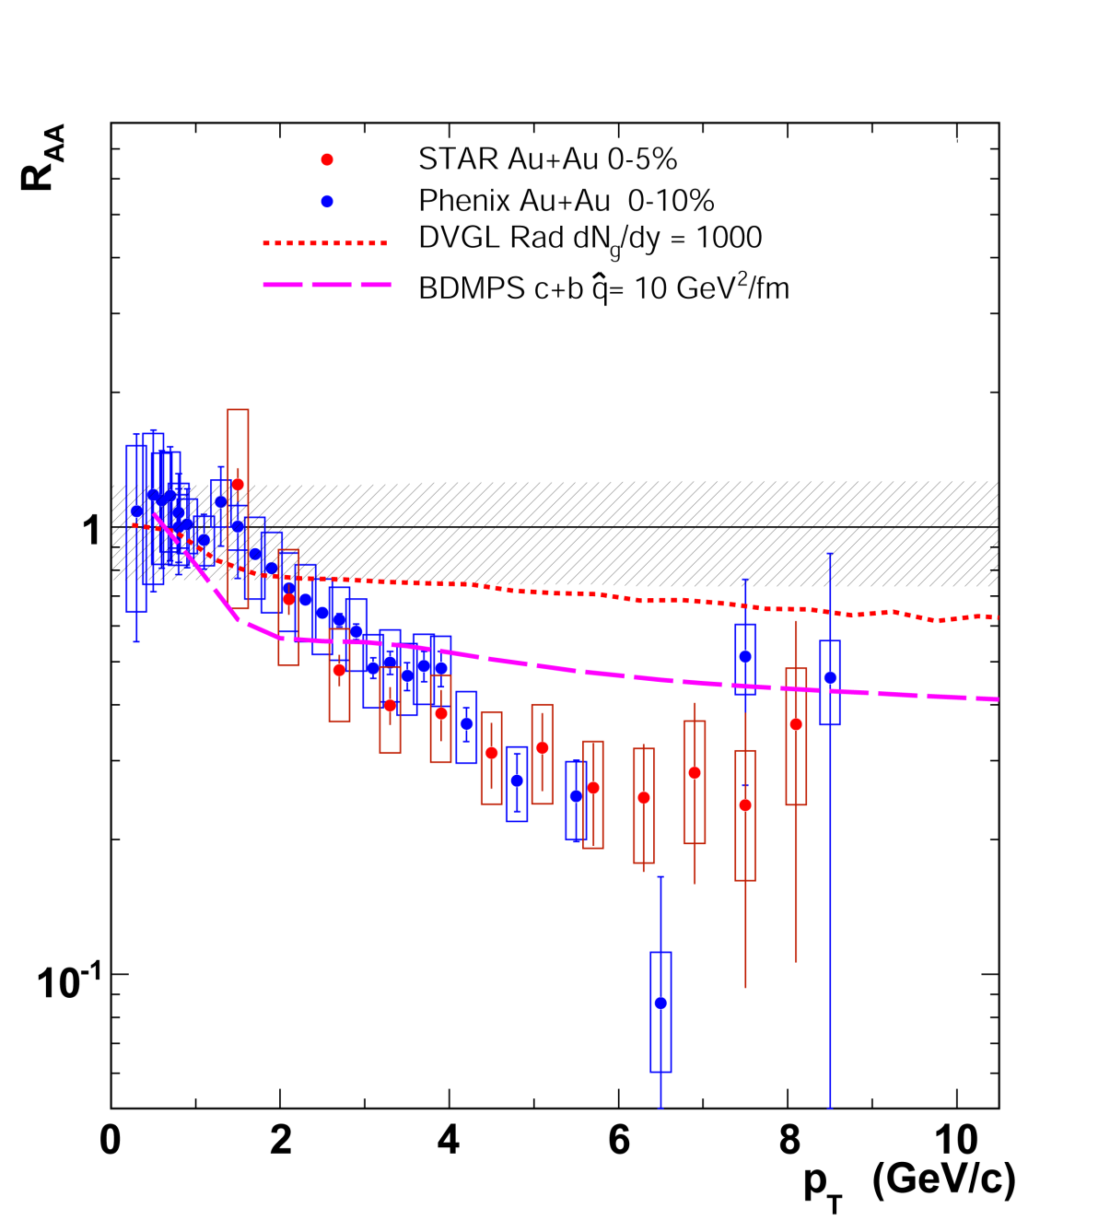
Nuclear Modification Factor
R_{AA} suppression found at high pt (same as for light quarks – induced gluon radiation)
Dead cone effect suggested high-pt R_{AA} suppression of heavy quarks should be less than that of lighter quarks.
Suppression larger than prediction -> sign of collisional energy loss?

Slide 40
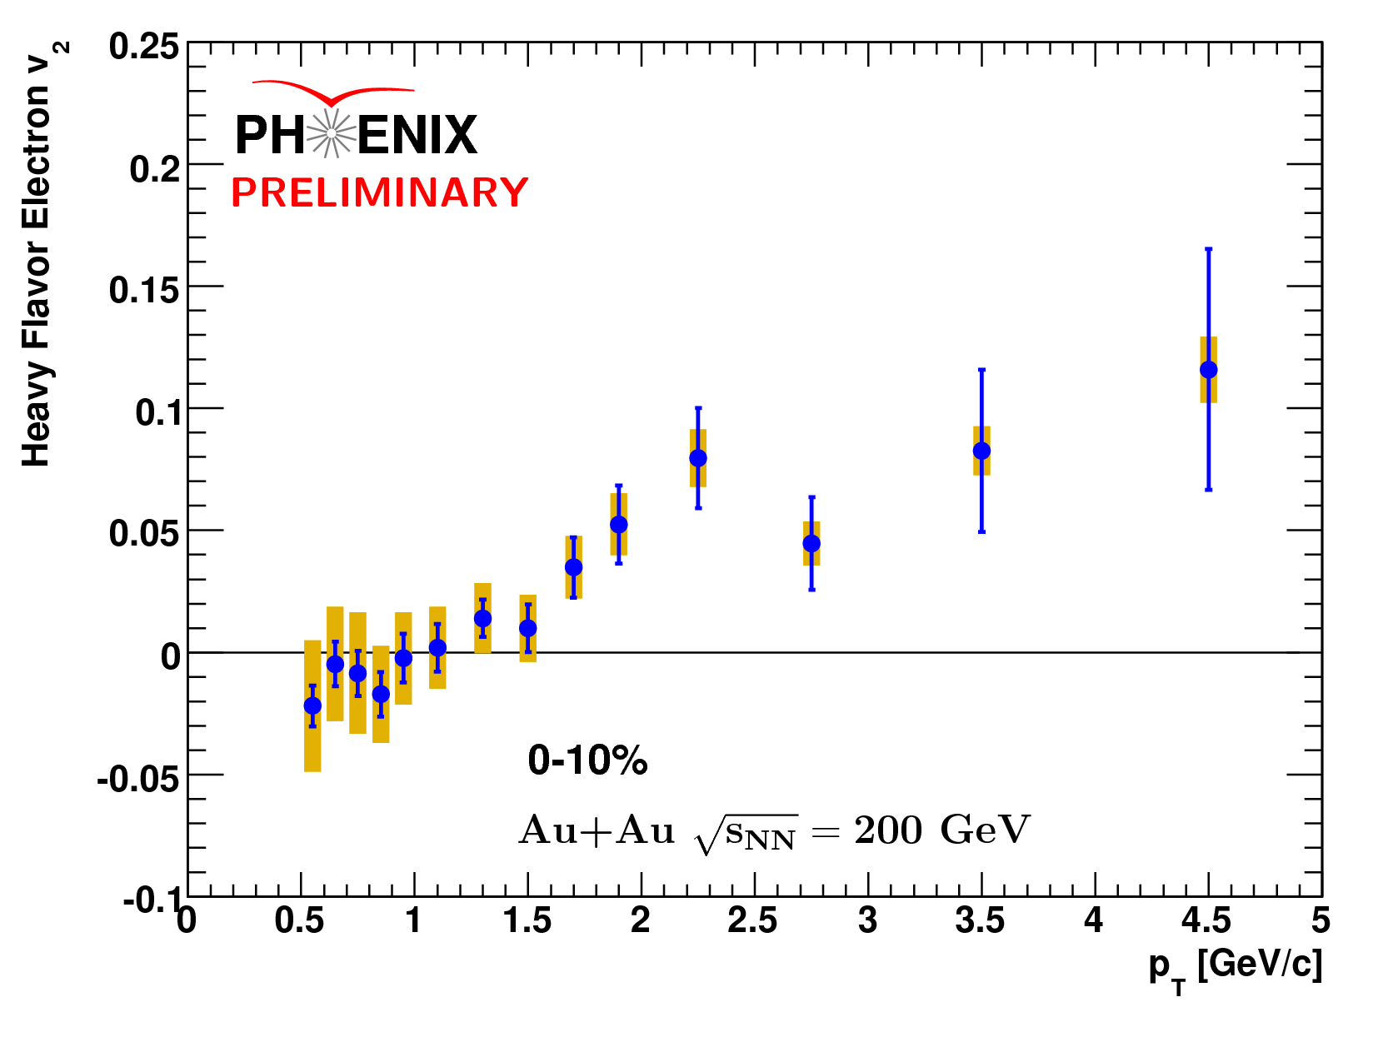
Heavy Flavor V₂
Charm flow a sign of thermalization
Higher p_{t} measurement can be improved
Charm/bottom separation important.
VTX inner silicon upgrade will help with this measurement.

Slide 41
Angular Charm/Bottom Separation Analysis

Slide 42
STAR Indirect Measurement of Beauty/Charm Ratio
(Based on
Wei Xie DIS2010)
K⁺
Primary Interaction Point
ν
D⁰
D⁰
cc
e⁻
π⁻
K⁺
Direct D⁰
Reconstruction
K⁻
x
D⁰
B⁻
B⁺
bb
e⁺
D⁰
π⁺
K⁻
Angular Direction of decay daughters can be used to indirectly estimate charm/bottom ratios even without vertex reconstructed

Slide 43
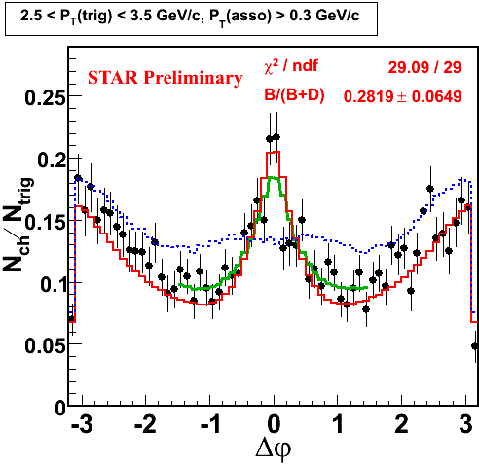
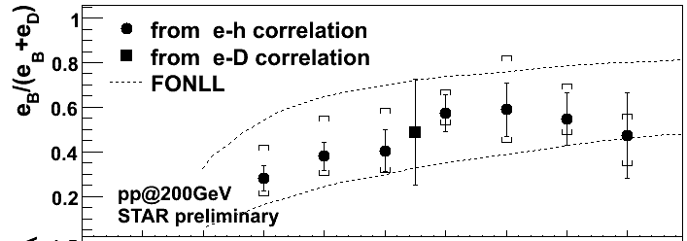
Indirect Bottom Measurement from STAR
Significant Bottom Contribution
Consistent with FONLL
Error Bars Still Large

Slide 44
Upgrades

Slide 45
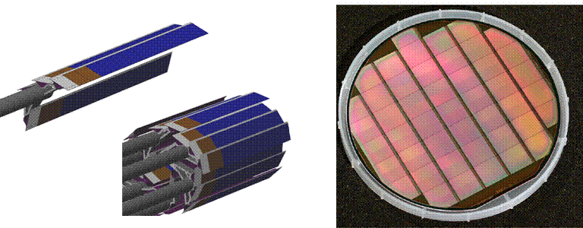
STAR Heavy Flavor Tracker
The STAR Heavy Flavor Tracker (HFT) is an improvement over the old SVT for tracking capabilities.
Replaces SVT with 3 layers of silicon
Point resolution of 10 μm (compare STAR-SVT with around 60 μm )

Slide 46
STAR Outlook
Can use SVT to find yields of all major open charm channels (D, D⁰, D_{s}) in 200 GeV Au+Au collisions.
HFT upgrades track resolution allowing stronger signals as well as a potential Λ_{c} measurement.
STAR will use HFT to separate charm and beauty semi-leptonic decays.

Slide 47
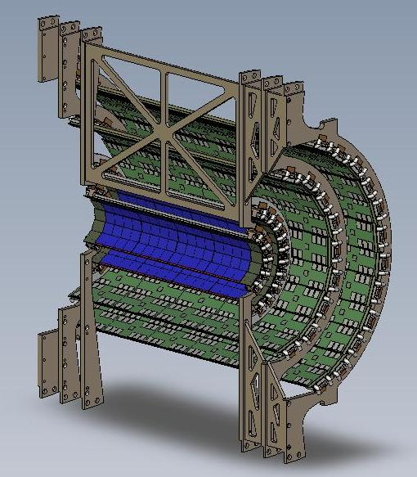
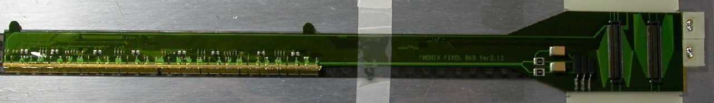
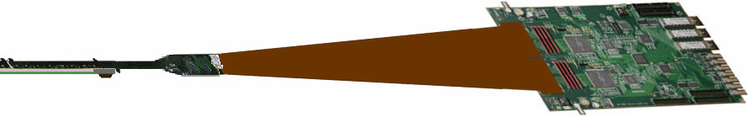
PHENIX Inner Silicon Vertex Tracker (VTX)
All pictures are from D. Winter’s 2008 RHIC/AGS User’s Meeting Talk
Outer Stripixel Layers
VTX Detector Size:
The detector length is 22 cm
Radius of 1st Layer (Pixel) = 2.5 cm
Radius of 2nd Layer (Pixel) = 5.0 cm
Radius of 3rd Layer (Stripixel) = 11.6 cm
Radius of 4th Layer (Stripixel) = 16.5 cm
Each pixel has a size of 50 X 425 μm²
The DCA resolution will be ~50 μm
Pixel Detector Ladder
Inner Pixel Layers
Readout Board

Slide 48

Global Tracks From D and B Decay Electrons
Simulation
p_{t} > 1 GeV

Slide 49

Distance-of-Closest Approach
Simulation

Slide 50



Charm/Bottom Separation Using the PHENIX-VTX
It has been shown in simulation that the geometric reconstruction of open charm and Beauty decays can be used to separately identify them.

Slide 51


Identification of D⁰s (and other heavy flavor mesons) using the PHENIX-VTX
Simulations show that D0s can be reconstructed topologically using the VTX detector.
Background and efficiencies are now being studied.
The D⁰ invariant mass peak using the VTX in simulation
QA of secondary vertex finding using the VTX

Slide 52
Goals of Analyses Using New RHIC Inner Silicon Tracking
Improve signal quality of heavy flavor measurements
Charm/Beauty separation
Elliptic flow of charm and beauty separately
R_{AA} of charm and beauty
Possible measurements of charm baryons

Slide 53

The ALICE Experiment
Like STAR, ALICE will used a TPC for track reconstruction
ALICE has an Inner Silicon Tracking Detector (IST) which will function like the STAR-SVT or PHENIX-VTX.
ALICE also uses electromagnetic calorimetry to detect electrons.

Slide 54



ALICE IST
DCA resolution of ~50 μm at p = 2 GeV/c will allow geometric identification of heavy flavor decays
Elena Bruna. WWND 08
SSD
SDD
SPD
L_{out}=97.6 cm
R_{out}=43.6 cm

Slide 55


ALICE Simulation Results
Heavy Flavor mesons can be directly reconstructed with much better significance than possible at STAR or PHENIX
Like PHENIX, DCA of electron tracks can be used for charm/beauty separation
Electrons tracks reconstructed using TPC, TRD, and EMCal
D⁺→K^{-f+f+}
(From Elena Bruna’s thesis)

Slide 56
Conclusions
STAR has measured the yields of charm mesons via direct hadronic decays showing binary scaling.
PHENIX and STAR have made semi-leptonic measurements of electrons from heavy flavor, showing large R_{AA} suppression at high-p_{t} and signs of flow.
Upgrades to both experiments as well as ALICE well improve capabilities to measure heavy flavor.

Slide 57



Results so Far and Open Questions (Backup)
Cross-Section Measurement
Au+Au and p+p cross-sections are above FONLL pQCD predictions.
Will the same pattern hold true for Cu+Cu and d+Au?
Will binary scaling be observed in these systems?
Nuclear Modification Factor, R_{AA}
Unexpectedly large suppression seen in R_{Au+Au}
What are the cold nuclear matter effects on R_{AA}? (observable through a d+Au electron measurement)
Azimuthal Anisotropy, V₂
Non-zero v₂ measured for Au+Au electrons.
Viscosity measured to be near the quantum limit.
Will a similar effect be seen in Cu+Cu?
What happens if measurement is extended to higher p_{t}?
4) Bottom/Charm Separation
What is the cross-section of bottom?
Will it show high p_{t} suppression?
Do bottom quarks flow in the medium?
Phys. Rev. Lett. 98, 192301 (2007)
Phys. Rev. Lett. 98, 172301 (2007)

