Slide 1

Heavy quarks as open quantum systems
Yukinao Akamatsu (KMI)
Y.Akamatsu, in preparation
Y.Akamatsu, A.Rothkopf, PRD85(2012),105011 (arXiv:1110.1203[hep-ph])
Y.Akamatsu, PRD87(2013),045016 (arXiv:1209.5068[hep-ph])
arXiv:1303.2976[nuch-th]

Slide 2
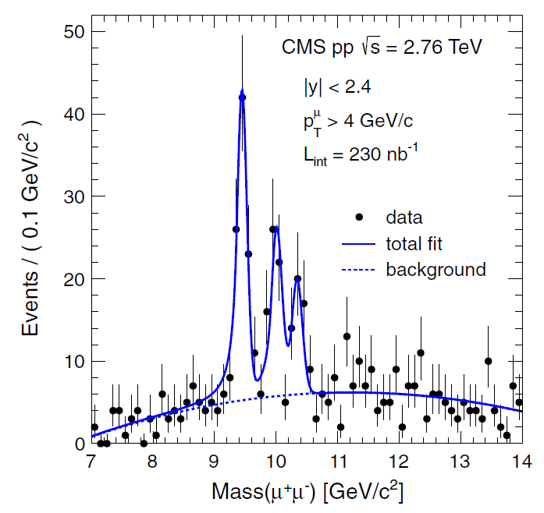
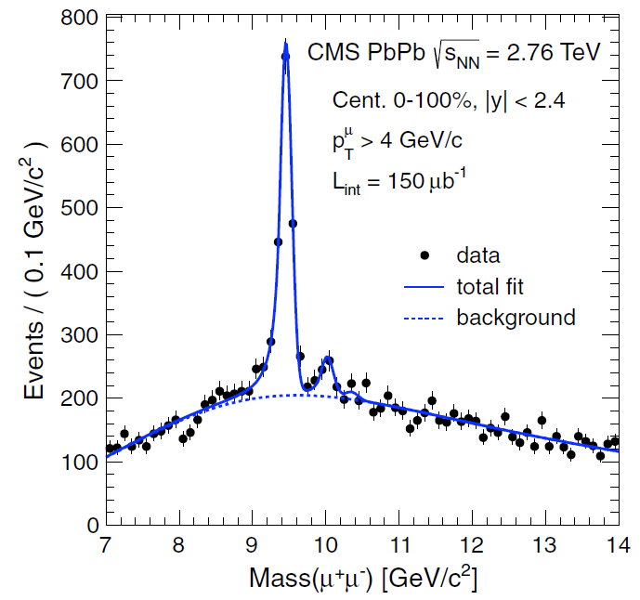
Quarkonium Suppression at LHC
CMS
Sequential melting of bottomonia
p+p
A+A

Slide 3
Contents
Stochastic potential and decoherence
Basics of open quantum systems
Quantum optical systems
Quantum Brownian motion
When is stochastic potential possible?
Summary

Slide 4
1. Stochastic potential & decoherence

Slide 5
In-medium potential
Definition
T>0, M=∞
r
R
Long time dynamics
Complex valued!
Laine et al (07), Beraudo et al (08),
Brambilla et al (10), Rothkopf et al (12).
t
σ(ω;R,T)
i=0 i=1 …
(0<τ<β)
Γ(R)
V(R)
ω
Spectral decomposition & Lorentzian fit of SPF σ(ω;R,T)

Slide 6
Stochastic potential
Stochastic unitary evolution
Akamatsu & Rothkopf (‘12)
Introduce noise Θ(t,X)
c.f. Density matrix
Non-local correlation is important
H(R)
Imaginary part = Local correlation only

Slide 7
Master equation
Density matrix
Master equation
Non-local correlation
HQ number conserved

Slide 8
Relative coordinate
Trace out global motion
Master equation
Stochastic potential
(R-independent)

Slide 9
Level occupation number
Projection to a state of interest
We only need ensemble of wave functions, from which occupation of any state is calculable.

Slide 10
Perturbative result for U(1)
Stochastic potential
Master equation for relative motion
Imaginary part of the potential

Slide 11
Intuitive picture
Random kicks to a wave function
Invisible area
Correlated noise
Uncorrelated noise
Invisible
Small bound state:
No thermal effect
Large bound state:
Decoherence →
Melting by thermal effect
l_{corr}~1/gT

Slide 12
2. Basics of open quantum systems
Based on “The theory of open quantum systems”,
Breuer and Petruccione (Oxford)

Slide 13
Very basics
sys = heavy quarks
env = gluon, light quarks
Setup
Hilbert space
von Neumann equation
Trace out the environment
Reduced density matrix
Master equation
(Markovian limit)

Slide 14
Born-Markov approximation
Interaction picture & 2nd order perturbation
Born-Markov approximation
assuming
Born approximation
Markov approximation
Separation of time scales: τ_{B} << τ_{R}

Slide 15
(1) Quantum optical systems
Interaction Hamiltonian
Rotating wave approximation
(interaction picture)
ω>0
ε’
A(ω)
ε
~ Hopping btw states with energy gap ω
(interaction picture)
RWA
Renormalization
Lamb shift
→ Lindblad form

Slide 16
(1) Quantum optical systems
Physical condition
Example: atomic level transitions
Separation of time scales
Rotating wave approximation
Uncertainty of energy (superposition of different levels)
→ In a long time, relative phase gets randomized and quantum superposition becomes statistical ensemble.
(Schrödinger picture)
Photon emission
Photon absorption

Slide 17
(1) Quantum optical systems
How about quarkonium melting
Separation of time scales
◯
Rotating wave approximation
？
I do not think the quantum optical approach is very suitable to quarkonium melting
But there are such works
Borghini et al (‘11, ‘12)

Slide 18
(2) Quantum Brownian motion
Caldeira-Leggett model
Master equation
(Schrödinger picture)
Time scale of system is slow
Momentum dissipation
Quantum decoherence
Ohmic environment

Slide 19
(2) Quantum Brownian motion
Physical condition
How about quarkonium melting?
Separation of time scales
◯
System timescale is slow
(◯)
If HQ momentum is p<<M for V(1/p)=-T, QBM approach is suitable. Furthermore in that situation, j*A iteraction (real gluon process) is subleading in HQ velocity.
→ Stochastic potential + momentum dissipation is the leading order process in velocity expansion!
~ T
Thermally relevant states

Slide 20
Quarkonium in sQGP
HQ potential in sQGP
Minimum theory of quarkonium melting
Stochastic potential
Momentum dissipation
Bottom M_{b}=4.5GeV, T~300MeV@LHC/RHIC
→ P/M ~ 1/3 : still OK
Y.Akamatsu (‘13)
and also in preparation

Slide 21
3. Summary
Stochastic potential = quantum decoherence
Applicable to slow HQs and for timescales shorter than HQ relaxation time
Future (ongoing) works
Master equation for quarkonium with stochastic potential and momentum dissipation in the Lindblad form
Simulation and phenomenology

