Slide 1
Heavy quarks in heavy ion collisions
Heavy Ion Pub
2010/08/17
Yukinao Akamatsu (Univ. of Tokyo)

Slide 2
Outline
Quark-gluon plasma and heavy ion collision
Heavy quark diffusion in heavy ion collision
Heavy quark diffusion from spectral function
Summary

Slide 3
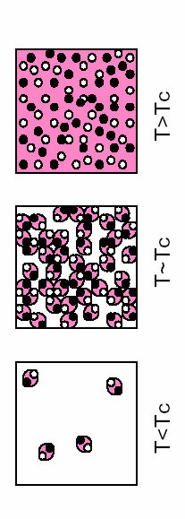

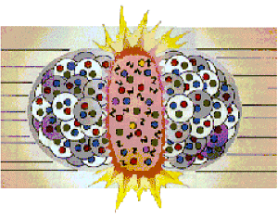

1. Quark-gluon plasma and heavy ion collision
Quantum Chromo Dynamics (QCD)
Asymptotic freedom
Confinement
QCD Phase Diagram
RHIC, LHC
QGP (quark-gluon plasma)
χSB
(chiral symmetry breaking)
CSC (color superconductivity)

Slide 4
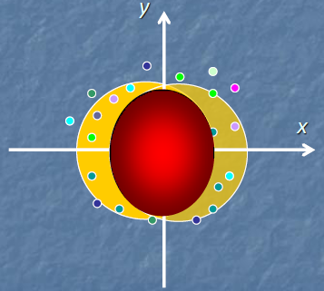
Heavy ion collision and hydrodynamic model
Dynamics of light particles (u,d,s,g)
hadron gas
time
QGP fluid
collision axis
0
z
Au
Au
Perfect fluidity, Local thermal equilibrium
Early thermalization, Hadronization

Slide 5
2. Heavy quark diffusion in heavy ion collision
Ref : Akamatsu, Hatsuda, Hirano, PRC79(‘09),054907, PRC80(‘09), 031901(R)
Charm and bottom in QGP
T/Mc,b<<1 → impurity probe
hadron gas
time
QGP fluid
collision axis
0
z
Au
Au

Slide 6
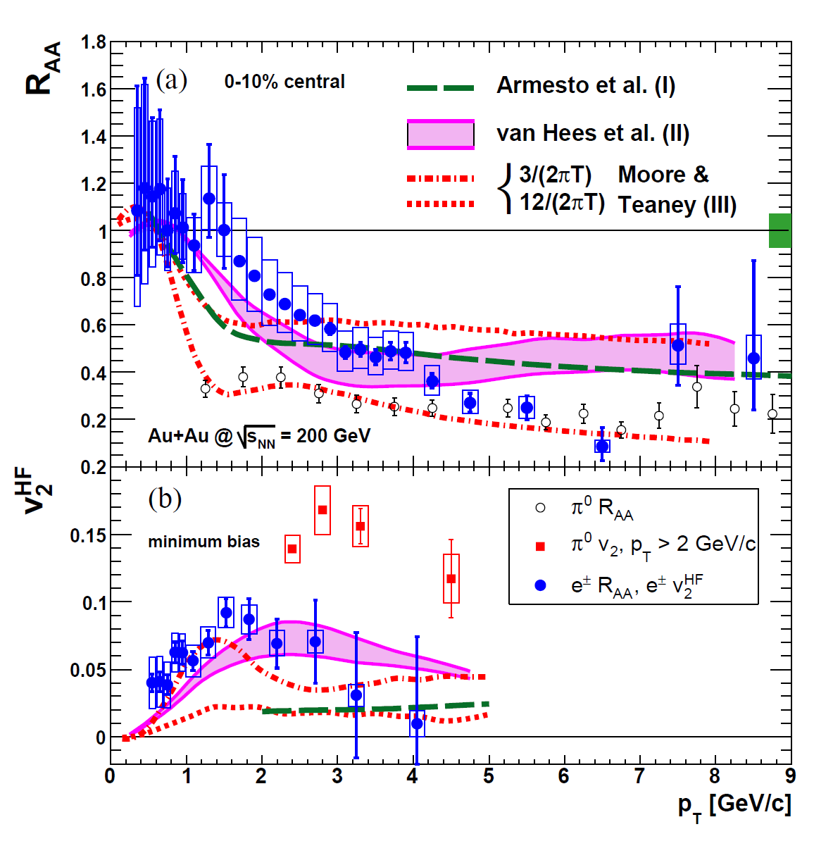
Previous works on charm and bottom in QGP
Radiative energy loss
Resonance scattering
Collisional energy loss
Based on weak coupling
or model calculation
How about
strong coupling “model”?

Slide 7
Model of heavy quark in medium
Relativistic Langevin equation
Fokker-Planck equation by Ito discretization
Generalized fluctuation-dissipation theorem

Slide 8
Drag coefficient γ
Weak coupling (pQCD)
(leading order)
Poor convergence
(Caron-Huot ‘08)
Strong coupling (SYM by AdS/CFT → sQGP)
N=4 SYM theory
[ for naïve perturbation]
(Gubser ’06, Herzog et al. ’06, Teaney ’06)
“Translation” to sQGP
(Gubser ‘07)

Slide 9
Heavy Quark Langevin + Hydro Model
0 fm….
Little Bang
generated by PYTHIA
0.6 fm…
Initial Condition
(pp + Glauber)
Local temperature and flow
Brownian Motion
Full 3D hydrodynamics
QGP
T(x), u(x)
(Hirano ’06)
Heavy Quark Spectra
_
c(b)→D(B)→e⁻ +ν_{e}+π etc
O(10)fm…
(independent fragmentation)
Electron Spectra + ….
Experiment
time
(PHENIX, STAR ’07)

Slide 10
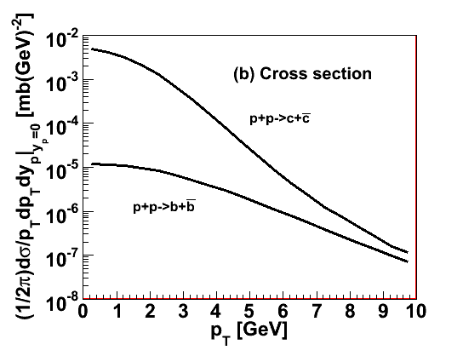
Notes in our model
Initial condition
<decayed electron in pp>
<HQ in pp>
available only spectral shape
above pT ~ 3GeV
Reliable at high pT
No nuclear matter effects in initial condition
No quark coalescence effects in hadronization
Where to stop in mixed phase at 1st order P.T.
→ 3 choices (no/half/full mixed phase)

Slide 11

Numerical Results
Nuclear Modification Factor
Experimental result ➔ γ=1-3
AdS/CFT γ=2.1±0.5
Different freezeouts
at 1st order P.T.
Bottom dominant

Slide 12
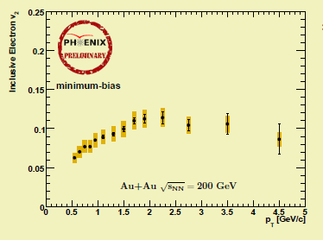
Elliptic Flow
Poor statistics, but at least consistent with γ=1-3.
(Still preliminary, PHENIX at Run7: v2~0.05-0.1 for pT~3-5GeV)

Slide 13
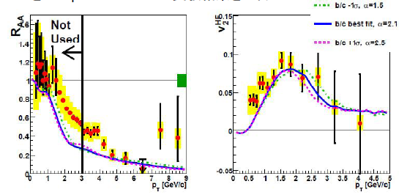
Including Recombination Model
Strong “medium” effect at freezeout can explain large v2.

Slide 14





Degree of HQ Thermalization
Stay time
Relaxation time
 | 22 | 6.7 | 2.2
 | 72 | 21 | 7.2
thermalized
not thermalized
Experimental result γ=1-3
charm : nearly thermalized,
bottom : not thermalized

Slide 15
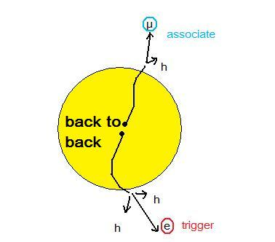
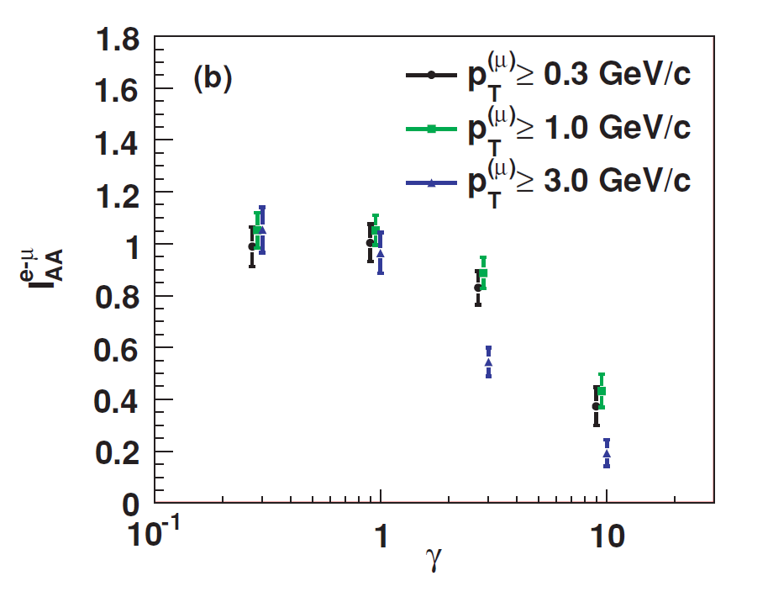
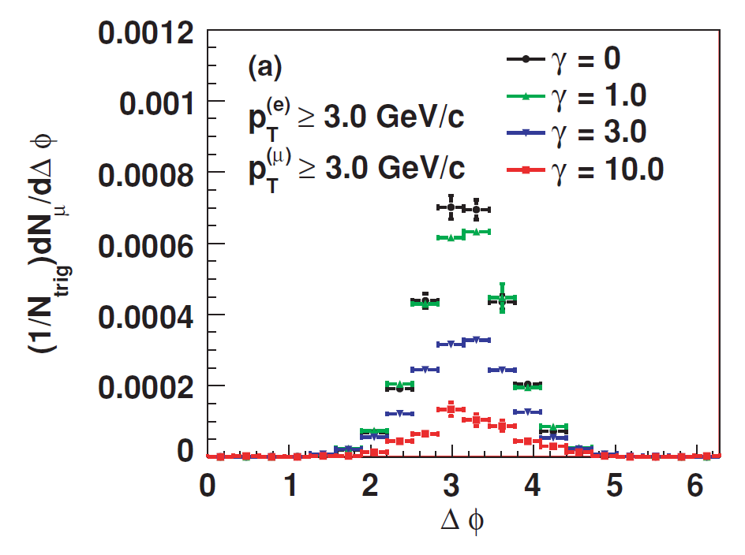
Azimuthal Correlation
Back to back correlation of a heavy quark pair
diffusion
Loss of correlation in decay products from D & B
e(mid)-μ(fwd) correlation : one peak
no contribution from vector meson decay
IAA : quantitative measure
e-μ azimuthal correlation: sensitive probe for heavy quark thermalization rate

Slide 16
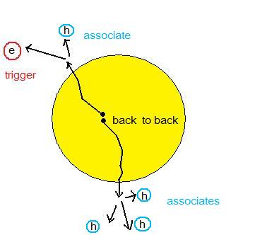
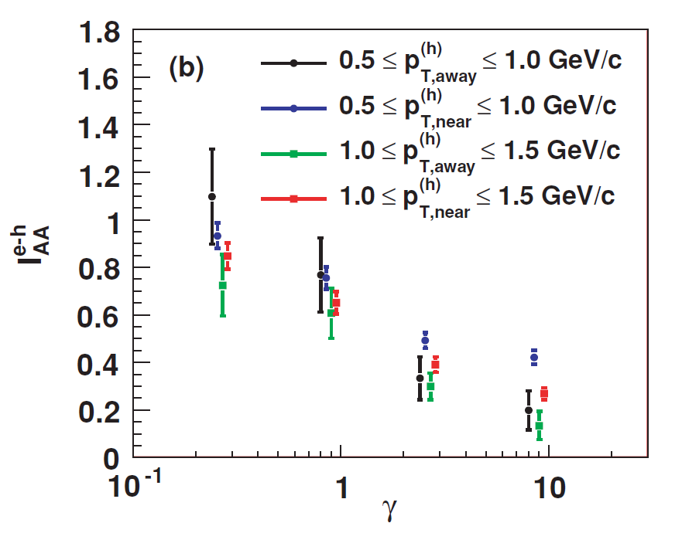
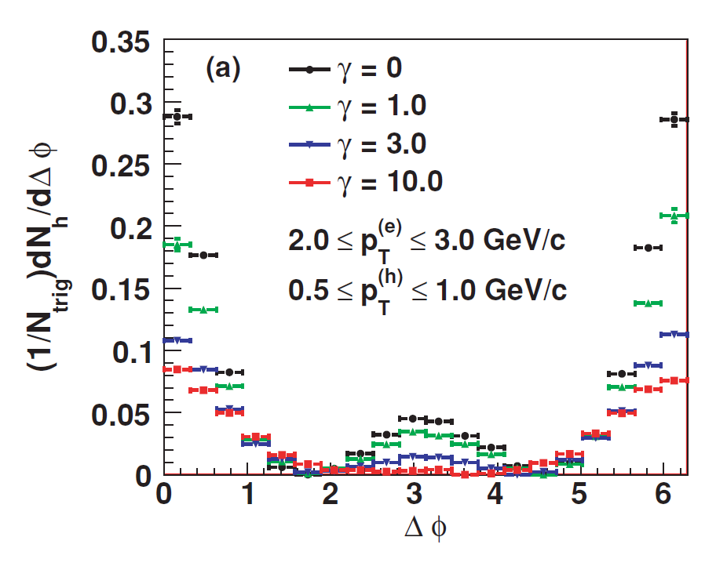
e-h correlation (mid) : two peaks
A sensitive probe but not clean …
Effects we ignore :
・Hadronic interaction of associates
・Medium response to HQ propagation
・Fictitious correlation due to bulk v2
Relative angle range for IAA
Near side : -0.5π≦Δφ≦0.5π
Away side : 0.5π≦Δφ≦1.5π

Slide 17
Outlook for updates
FONLL initial condition
Systematic study using Bag EoS and Lattice EoS for hydro

Slide 18
3. Heavy quark diffusion from spectral function
Goal
Non-perturbative definition of drag parameter
Ref :
Petreczky and Teaney ‘06
Caron-Huot and Moore ’08
Caron-Huot, Laine and Moore ’09
Burnier, Laine, Langelage, Mether ‘10

Slide 19
Response and spectral function
Linear response theory
Switch off external field A0 at t=0
Response at t>0
“hydrodynamics”

Slide 20
Spectral function from “hydrodynamics”
Conservation law
Constitutive equation
(Introduction of relaxation time τ)
Response at t>0

Slide 21
Spectral function from Fokker-Planck equation
(Non-relativistic) Fokker-Planck equation
Definition of current

Slide 22
Conservation law
Constitutive equation

Slide 23
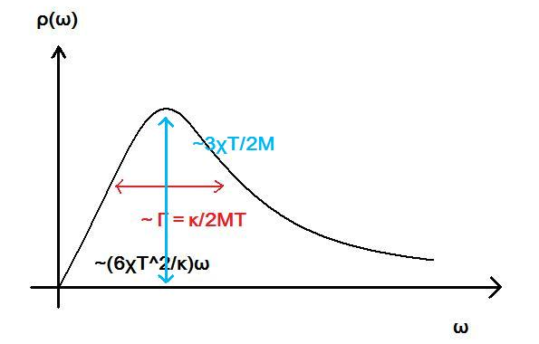
Kubo formula for the drag parameter
“normal” Kubo formula
g→0
M→∞
Very tiny peak for very heavy quark
Very narrow and steep for weak coupling
Euclidean correlator → SPF
(Petreczky and Teaney ‘06)
Lattice calculation for Euclidean correlator
is found to be insensitive to diffusion constant κ.
→cannot extract κ

Slide 24
Alternative definition of the drag parameter
No sharp or low peak expected
because EQ is not even an approximately conserved quantity.
M→∞: too heavy to change velocity, therefore spatial current is conserved.
g→0: spatial current will not undergo scattering, therefore conserved.
Leading order perturbation
→ Wilson line=1
Hard Thermal Loop
Caron-Huot and Moore ’08

Slide 25
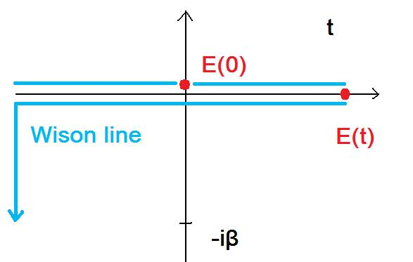
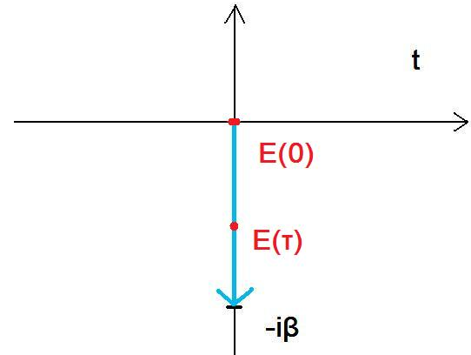
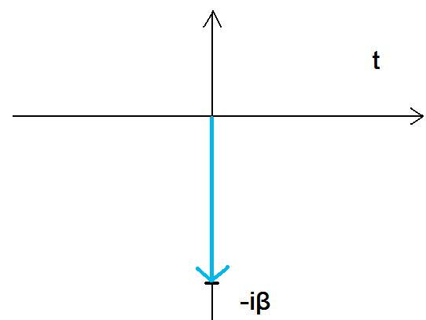
Integrating out heavy quark field
Real time contour
Corresponding Euclidean correlator
Tr
Tr

Slide 26
A way to lattice QCD
Caron-Huot, Laine and Moore ’09
Lattice calculation around Tc may be a noisy measurement
because of the Polyakov in the denominator of G(τ).

Slide 27
4. Summary
Heavy quark drag parameter Γ~2T²/M is extracted
from phenomenological study.
Drag parameter near Tc is interesting and may be relevant
to heavy quark hadronization.
Heavy quark (momentum) diffusion constant κ is defined
non-perturbatively.
In near future, lattice determination may be possible.

