Slide 1
LHC-ALICE実験の第一次運転成果と今後の展望
Taku Gunji
Center for Nuclear Study
The University of Tokyo
gunji@cns.s.u-tokyo.ac.jp
Heavy Ion Pub, 5/31/2013 @ Osaka Univ.

Slide 2
Outline
Introduction
LHC
4大実験
LHC-ALICE実験運転
LHC Run-Iの成果
今後の展望
ALICEアップグレード計画
まとめ
お詫び:
当初の予定では、“成果<展望, ALICE次期計画“の予定でしたが、
“成果>>展望、ALICE次期計画”になってしまいました

Slide 3
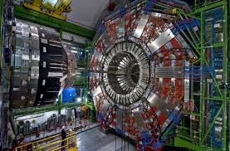
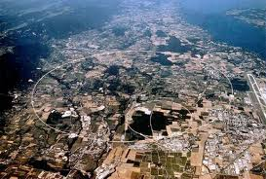
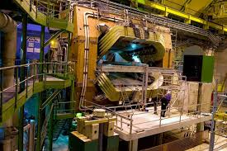
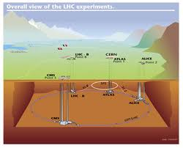
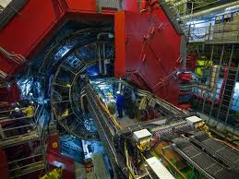
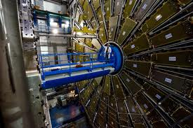
Large Hadron Collider
周長=27km, 各種=p, Pb, (Ar)
√s_{NN}= 7TeV (p-p), 5.5TeV (Pb-Pb)
L= 10³⁴ cm⁻²s⁻¹ (p-p) x 100 RHIC (2012)
L= 10²⁷ cm⁻²s⁻¹ (Pb-Pb) x 0.2 RHIC (2012)
CMS
LHCb
ALICE
ATLAS

Slide 4
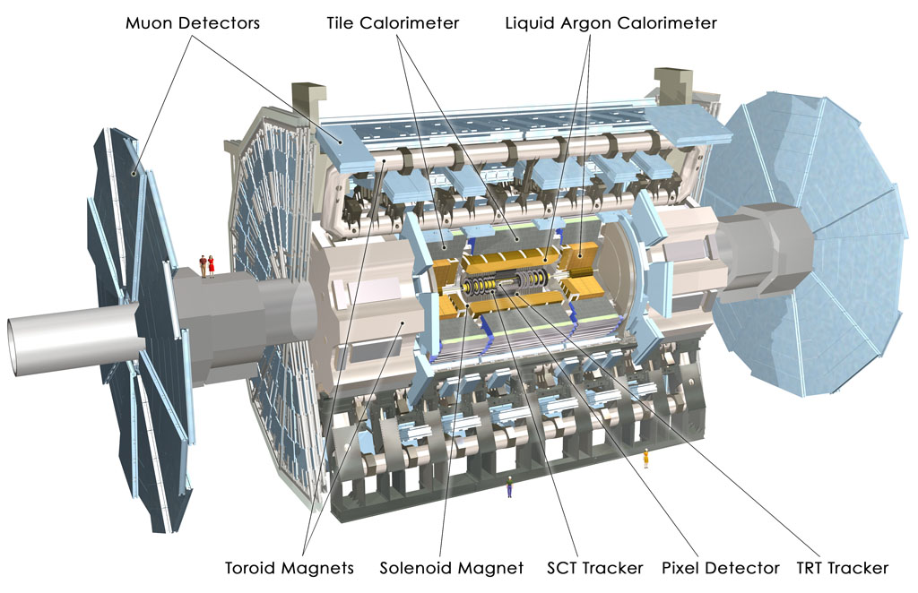
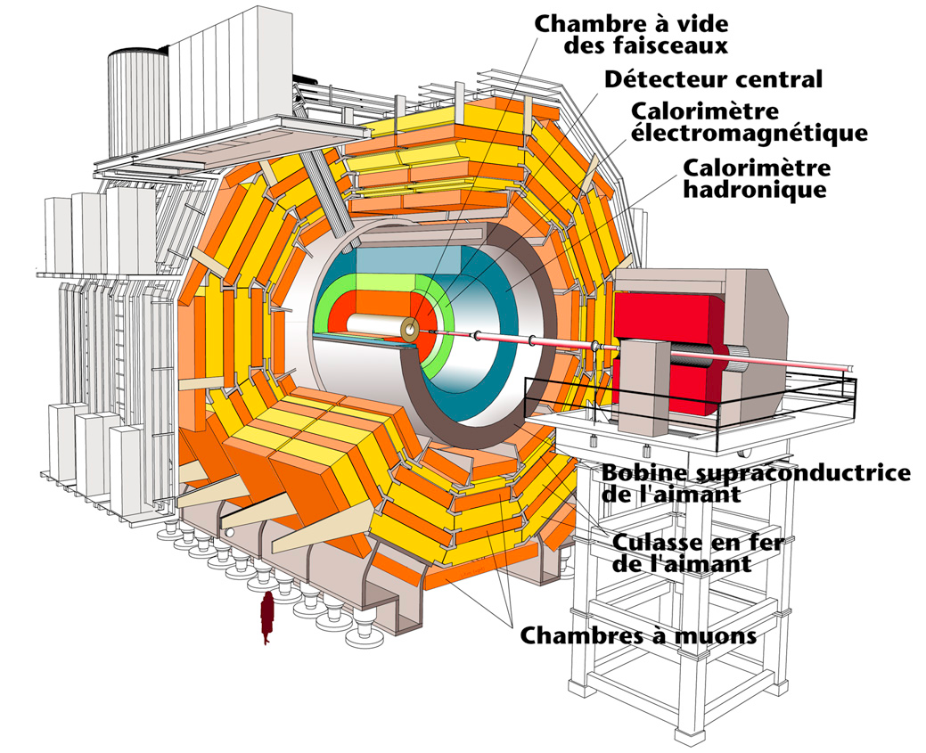
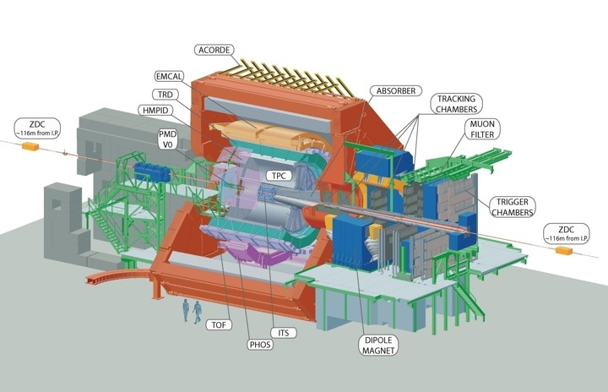
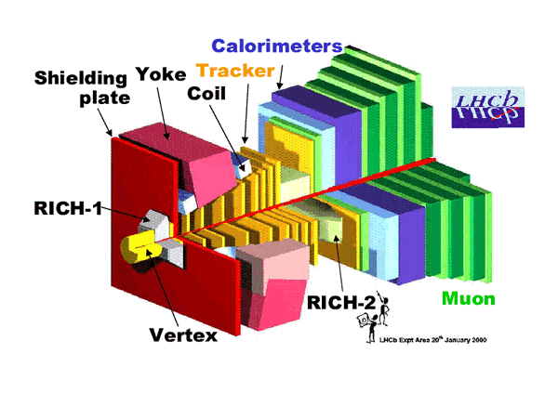
4大実験

Slide 5
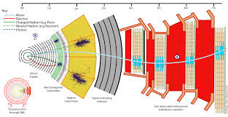
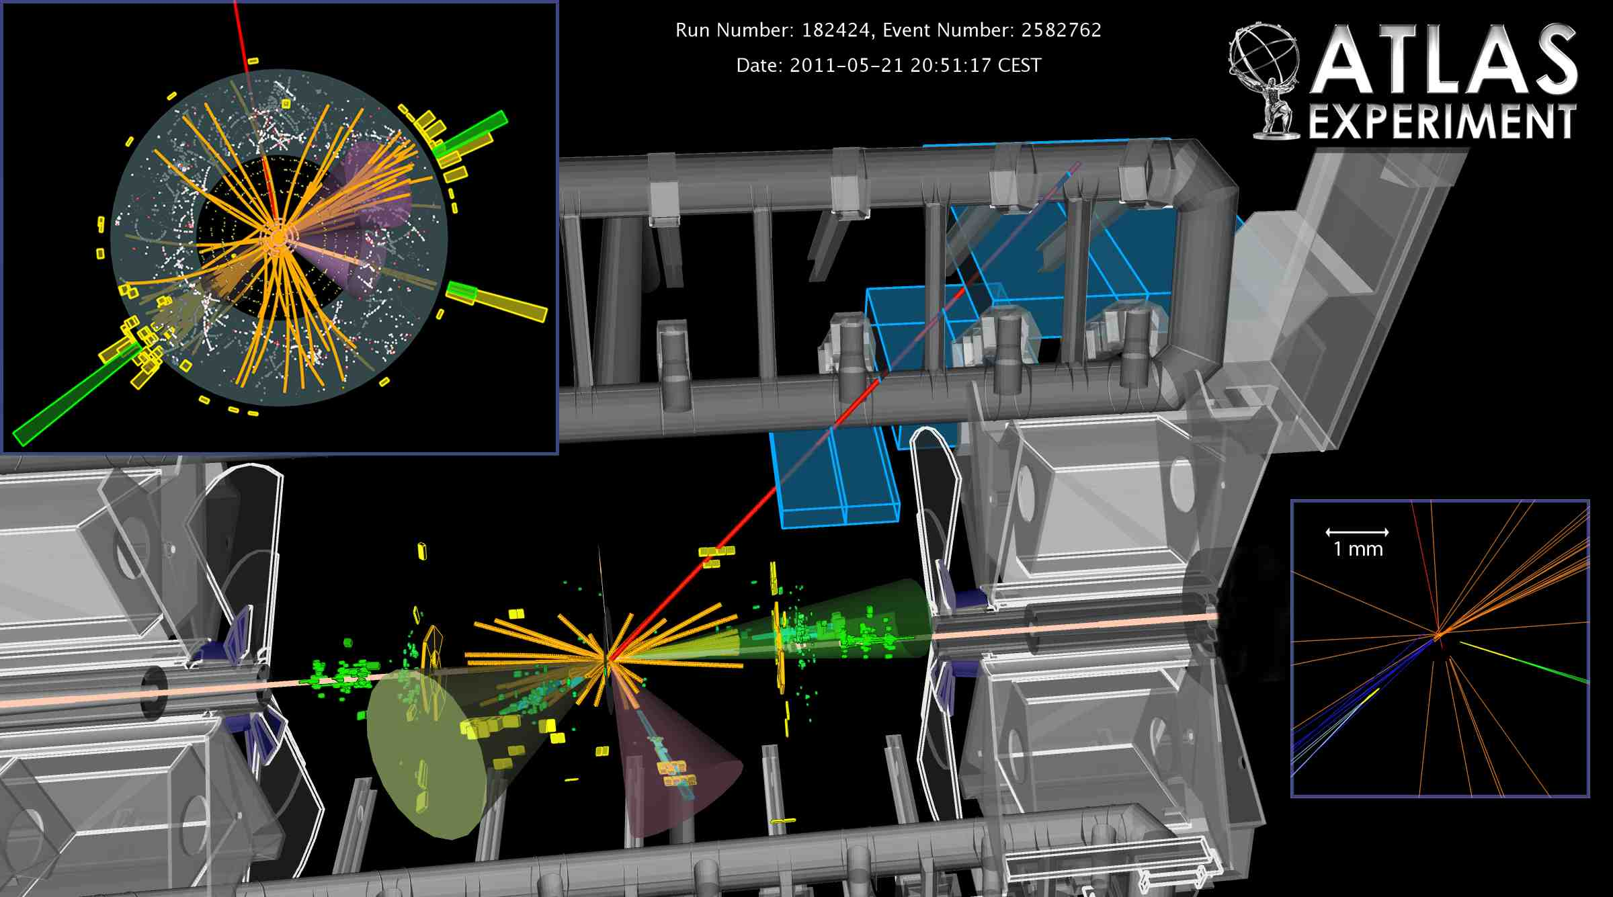
CMS, ATLAS実験
ジェット、inclusive hadron測定、レプトン(対)、光子測定に強い. 大きな除去能を持つ多段トリガーで、大きなinspection event. 1 bunch内での多重衝突、Event pile upにも対応

Slide 6
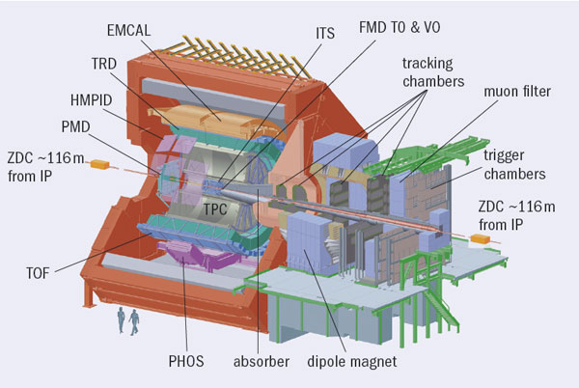
LHC-ALICE実験
多くの測定量に特化した検出器群
他の実験に比べて、統計が貯められない(検出器の仕様、読み出し仕様)が、多種ハドロン、光子、レプトン、ジェットを広範な運動量領域(ソフト〜ハード)で測定する。 低運動量のJ/ψはALICEのみ。

Slide 7
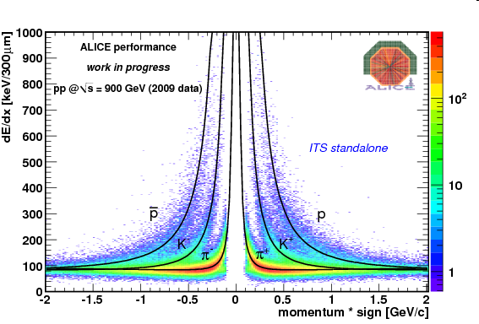
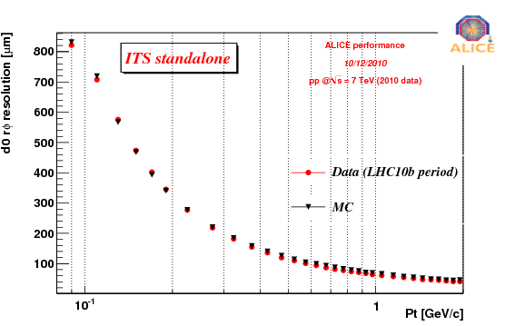
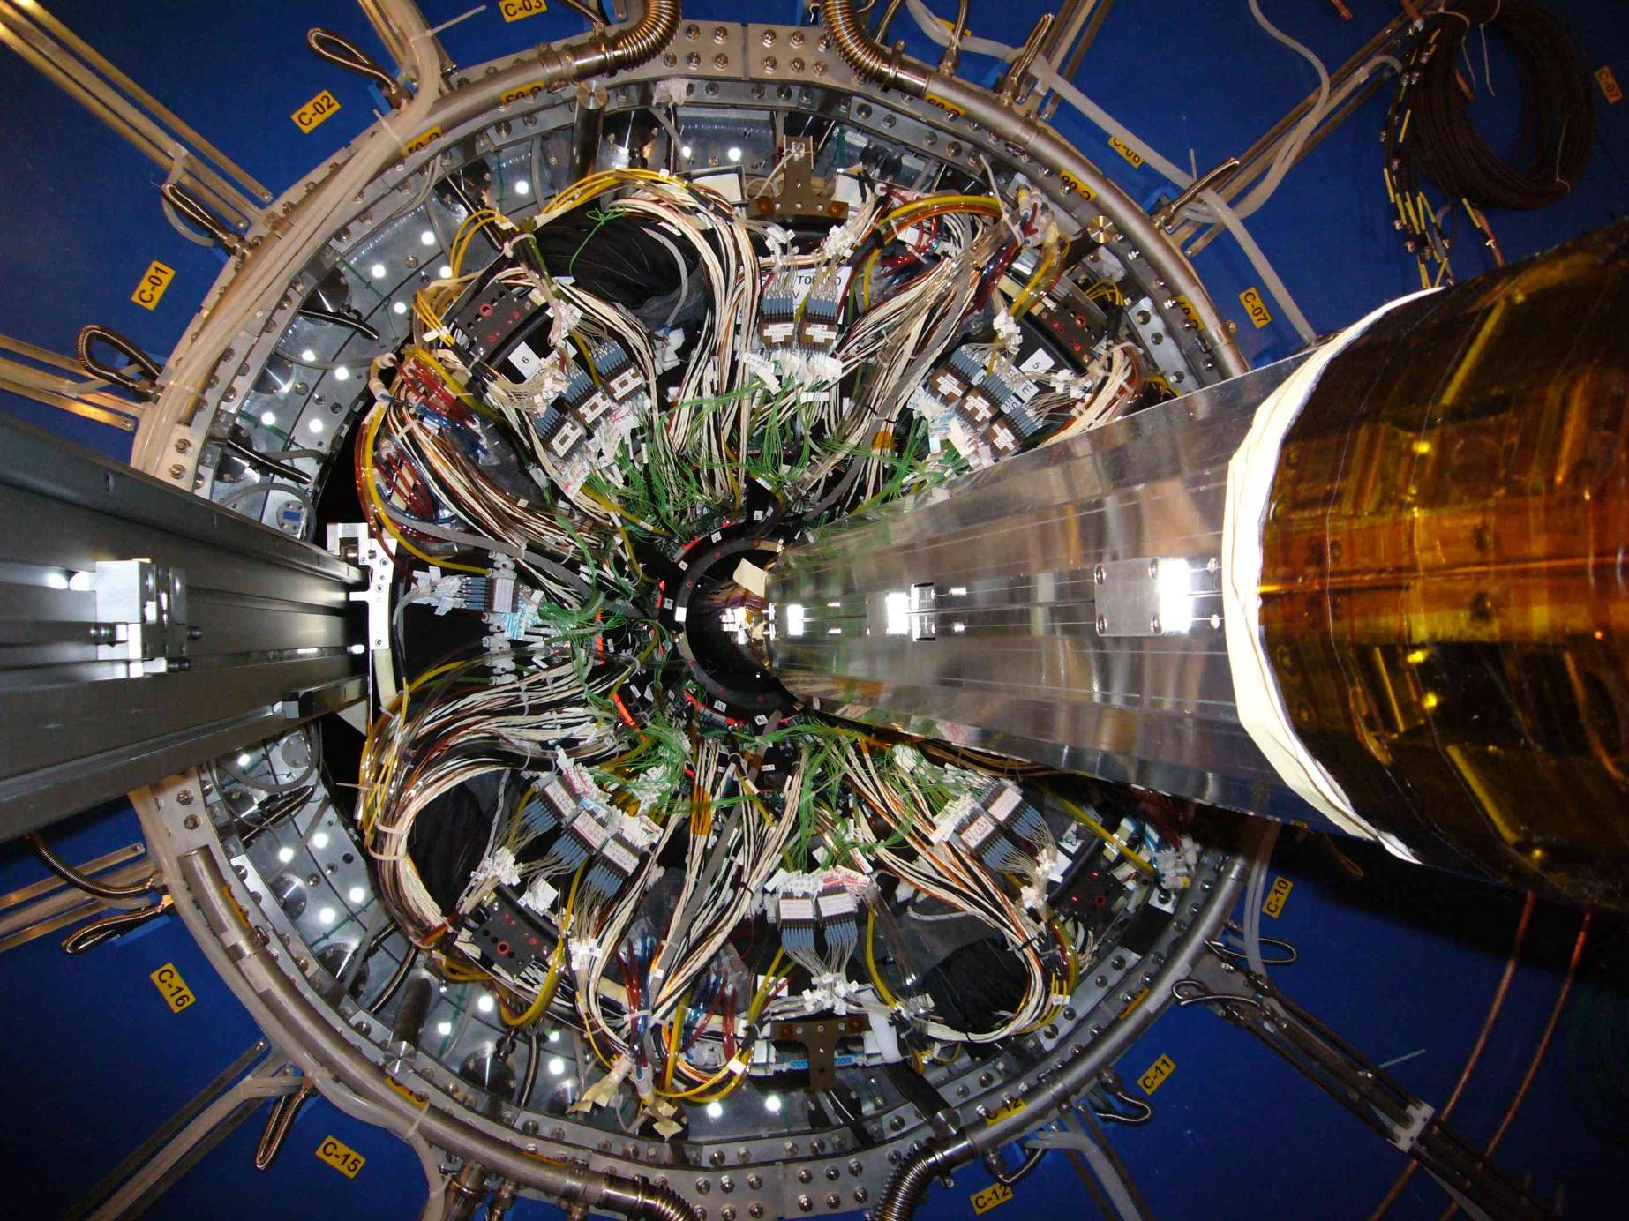
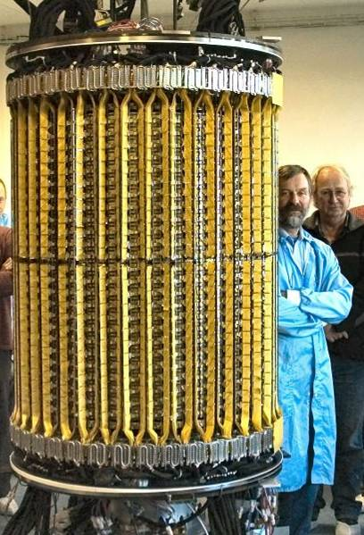
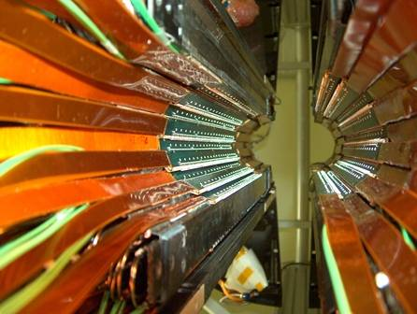
Inner Tracking System
シリコン検出器(Pixel/Drift/Strip)で構成
事象トリガー、粒子多重度、衝突点、PID(π/K/p)
重クォーク(D/B)の崩壊点測定
σ(rφ) vs. p_{T}
TPC
SPD
SSD/SDD

Slide 8
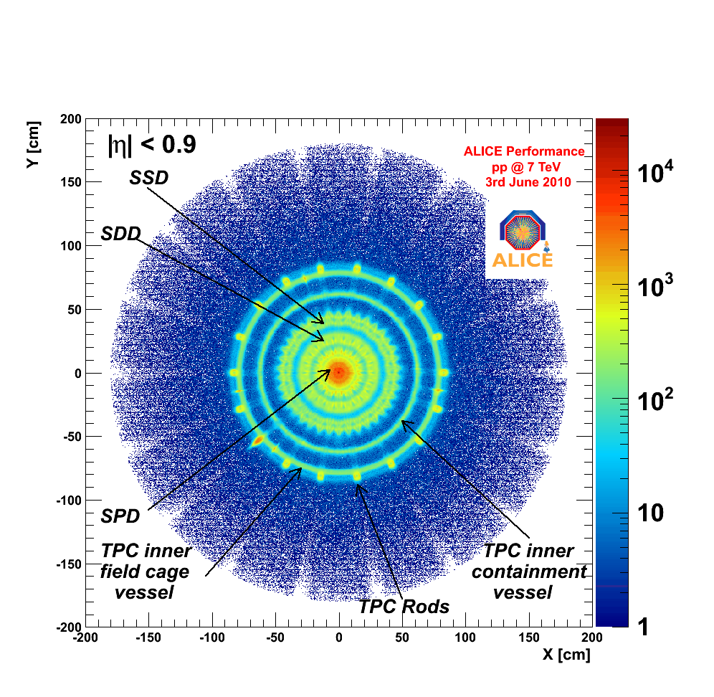
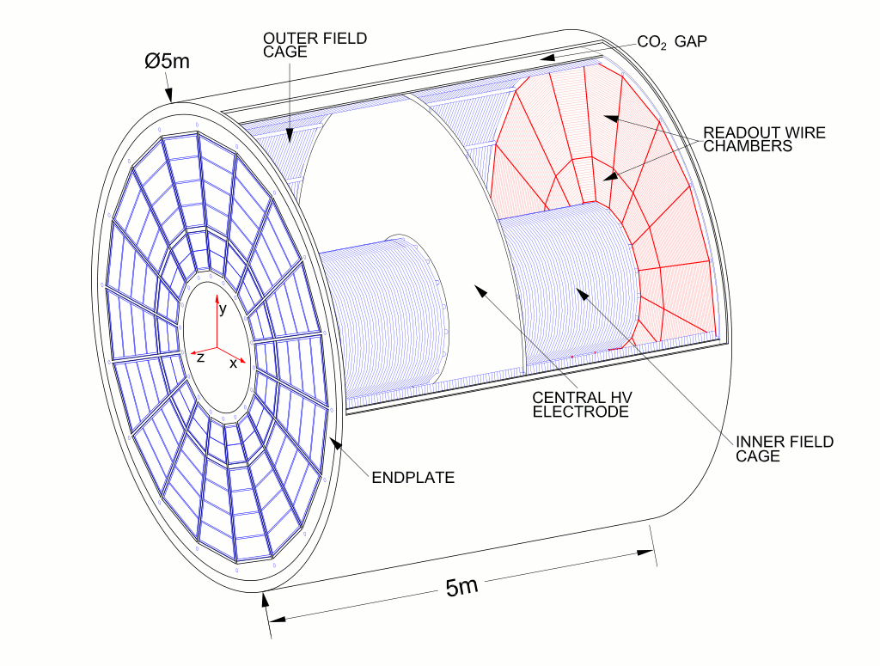
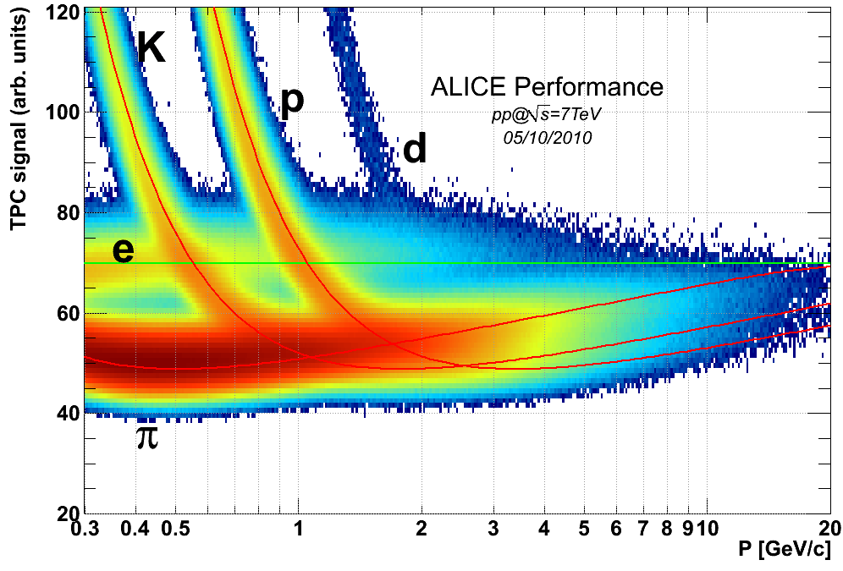
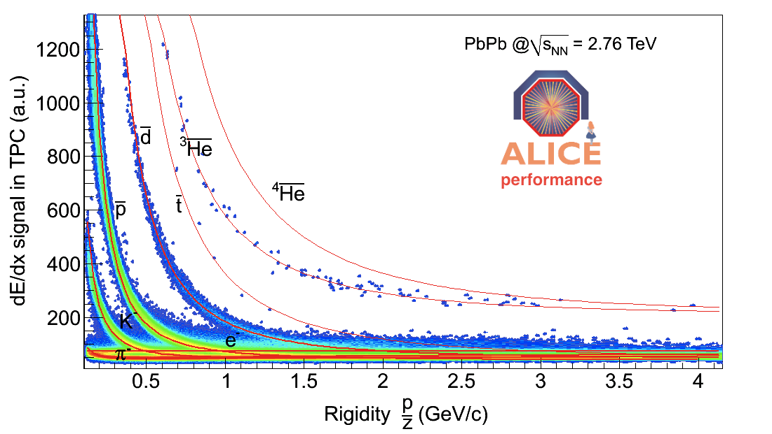
Time Projection Chamber
ALICEのメインな飛跡検出器
世界一大きなTPC, 80m³
PID, kink K(K->μ+ν), multi-strangeness(Ω/Ξ/Λ), photon conversion、Δp/p=7%@10GeV
Drift length=2.5m
Drift field ~ 400V/cm
Ne-CO2-N2(85.7%:9.5%:4.8%)
Low diffusion, high drift velocity
gy
B field
z
gx
E field
IP
beam
A side
ROC
100kV
C side
(muon-side)
ROC

Slide 9
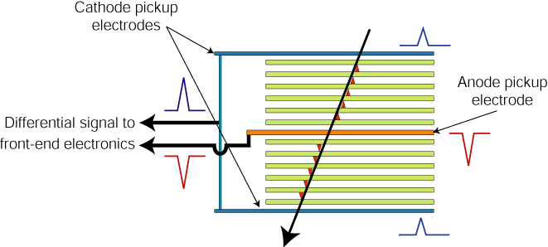
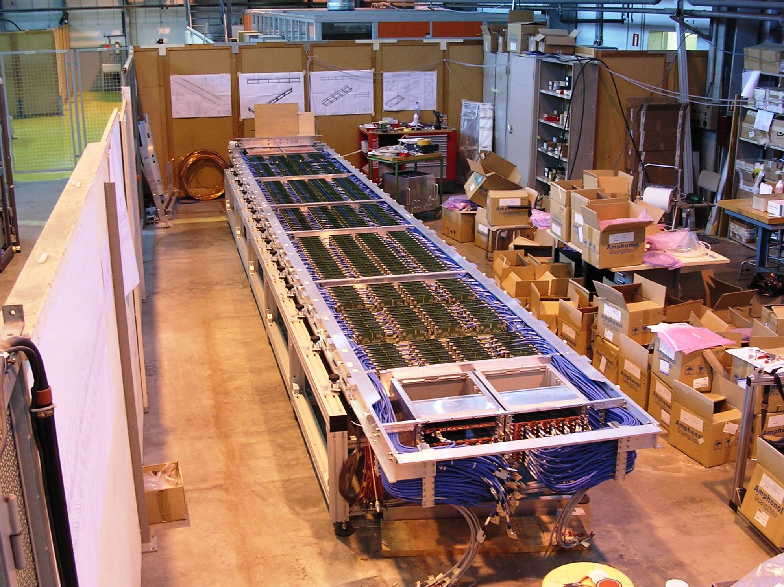
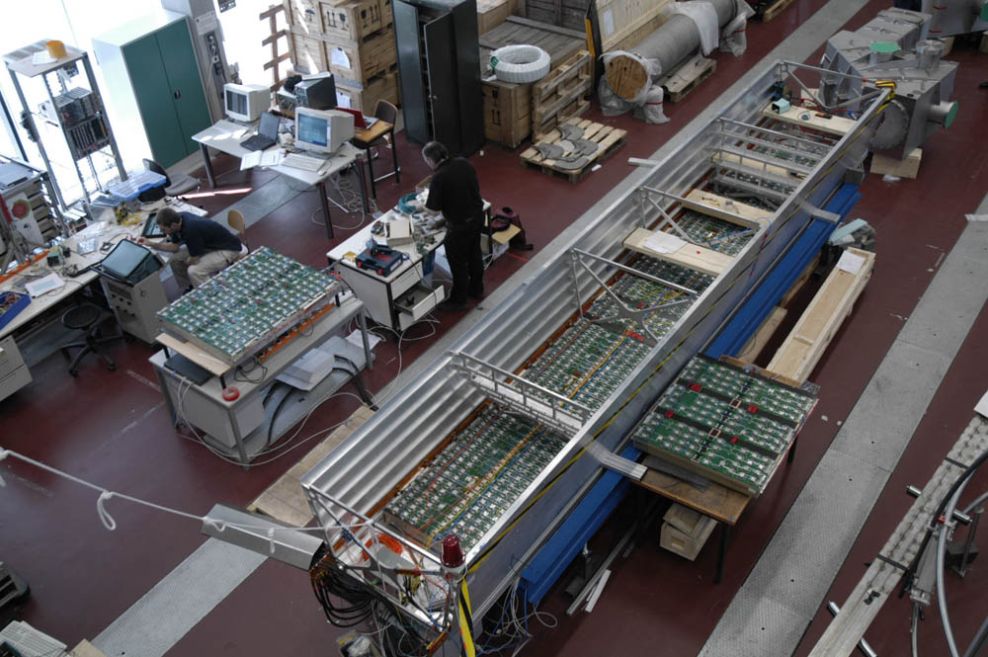
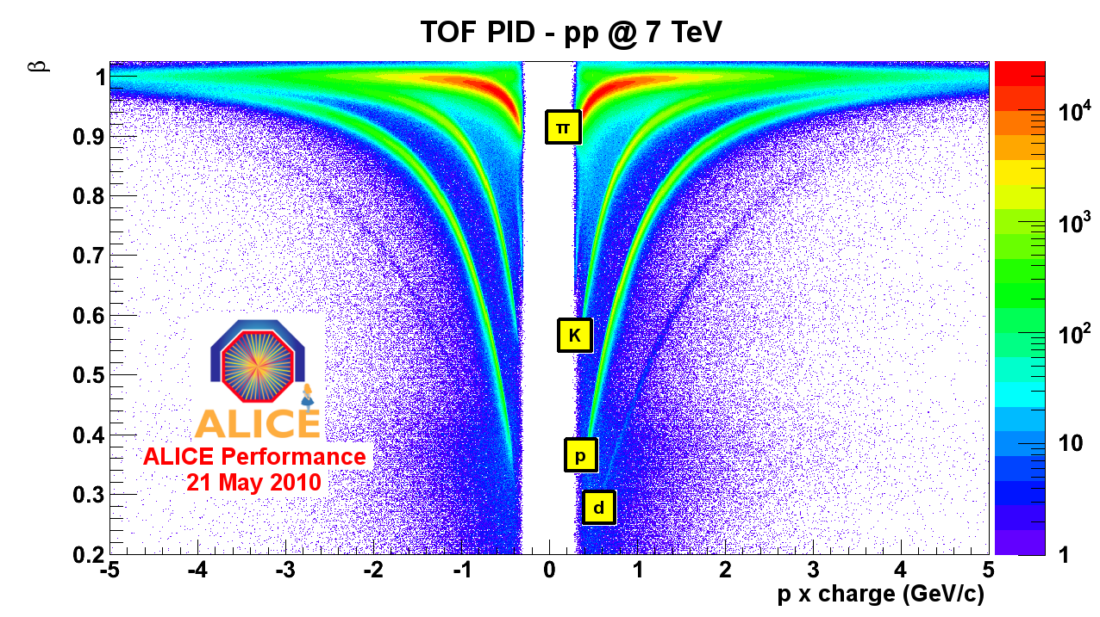
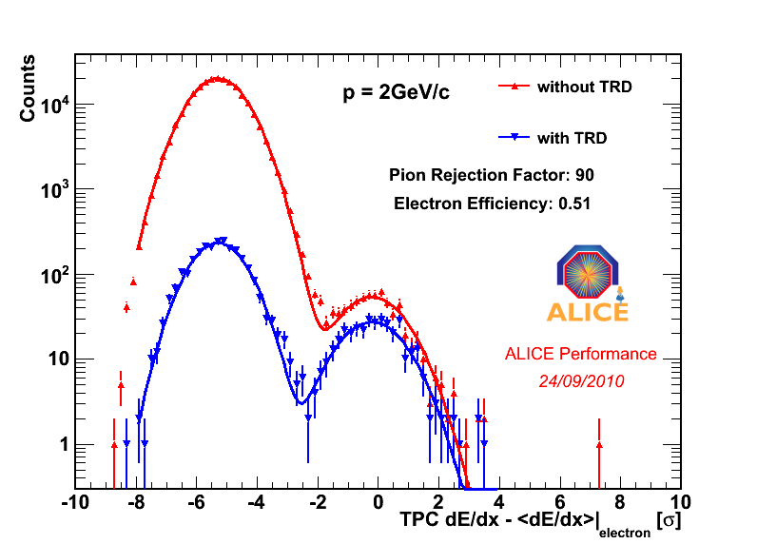
TRD/TOF
TRD(6層)
遷移輻射の検出による電子同定、電子トリガー
高運動量荷電粒子同定
輻射体+MWPC(Xe(85%)-
CO₂(15%))
TOF
MRPC: σ=50ps
粒子識別(pi/K/P)

Slide 10
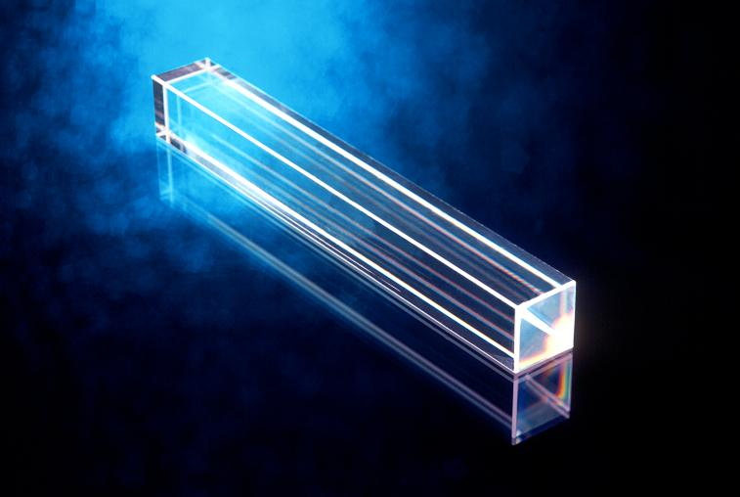
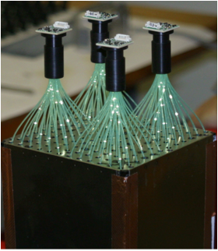
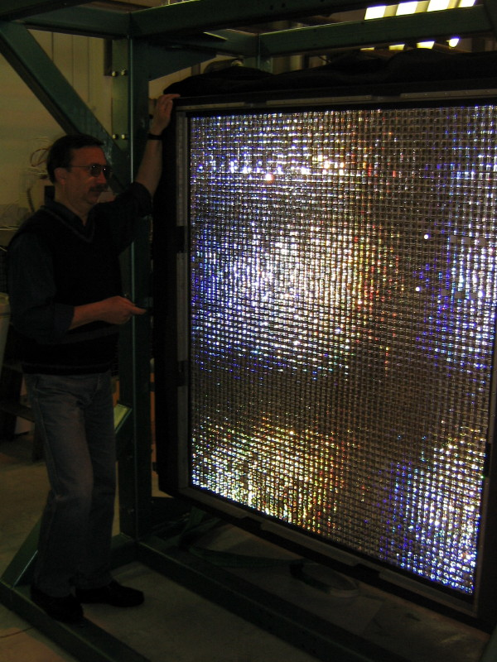
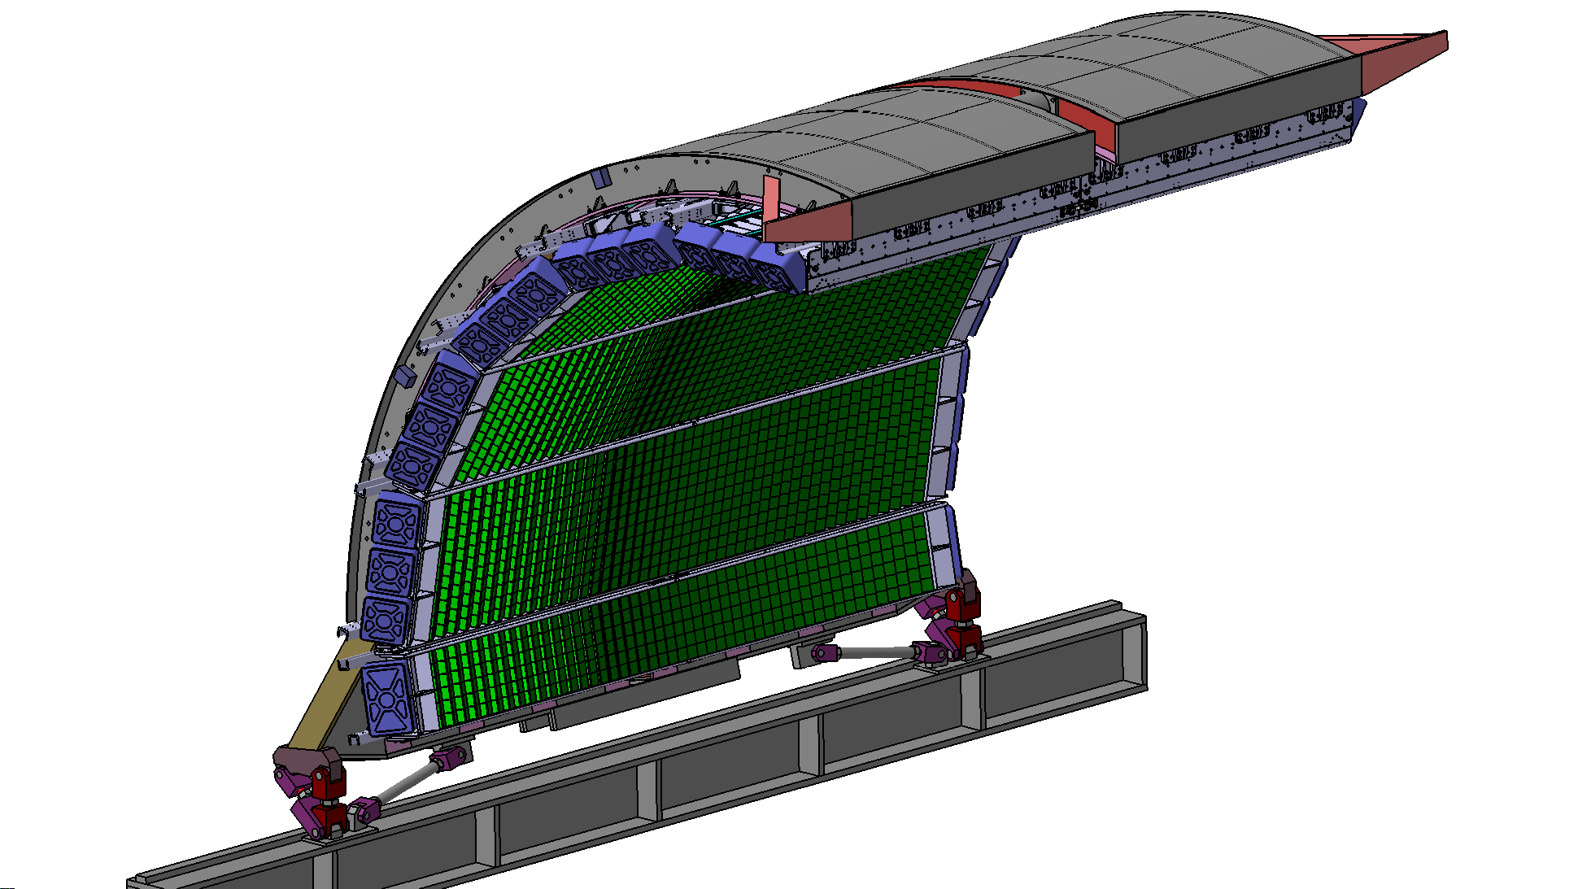
Calorimeters
２種類の電磁カロリメータ
EMCAL(PbSc), PHOS(PWO)
π⁰、jet、光子測定。L₀/L₁トリガー

Slide 11
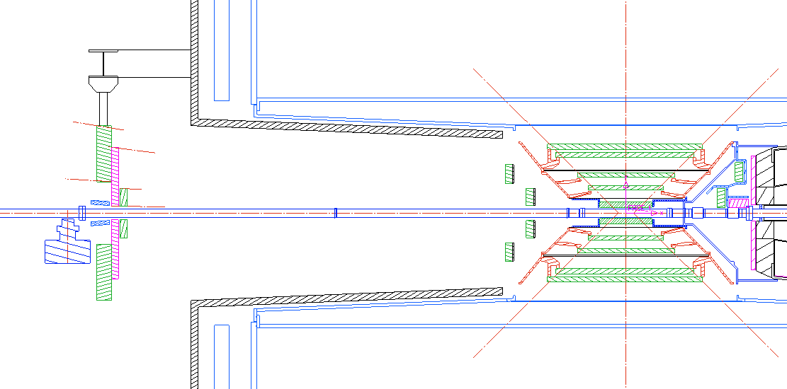
Main Trigger Devices
V0A
8 cm < r < 100 cm
SPD
V0C
8 cm < r < 76 cm
Interaction point
340 cm (11 nsec)
90 cm (3 nsec)
Scintillator paddles placed at 90 cm or 340 cm away from the interaction point (V0-C and V0-A)
32 channels PMT readout for each
SPD (Silicon Pixel Vertex detector)

Slide 12
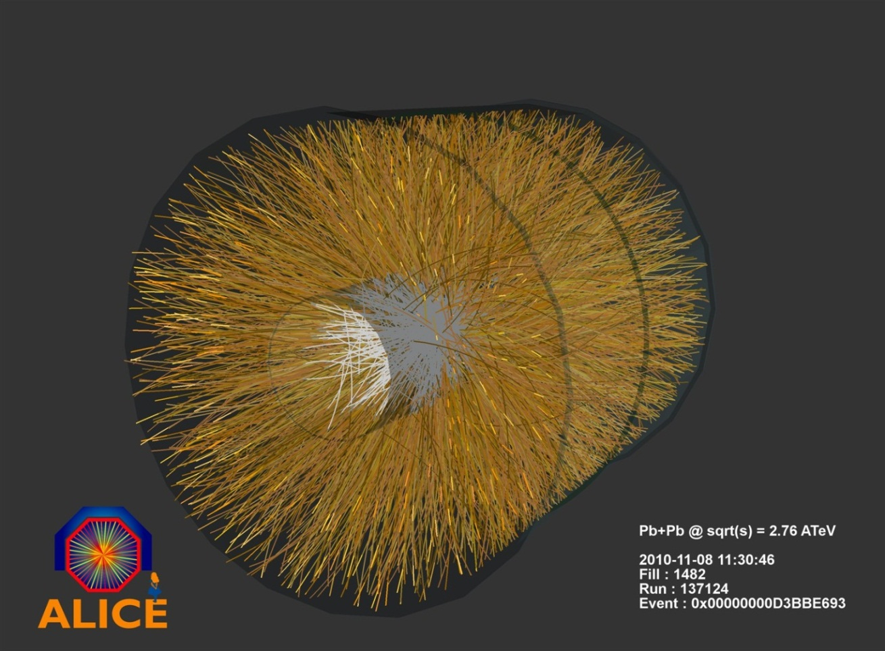
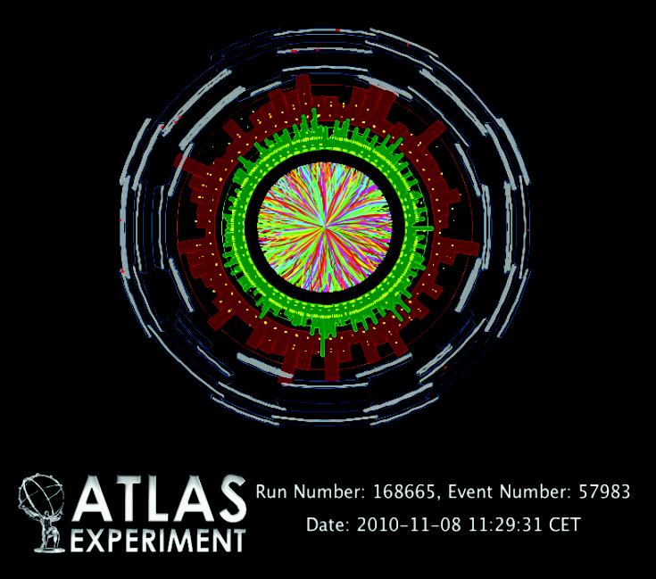
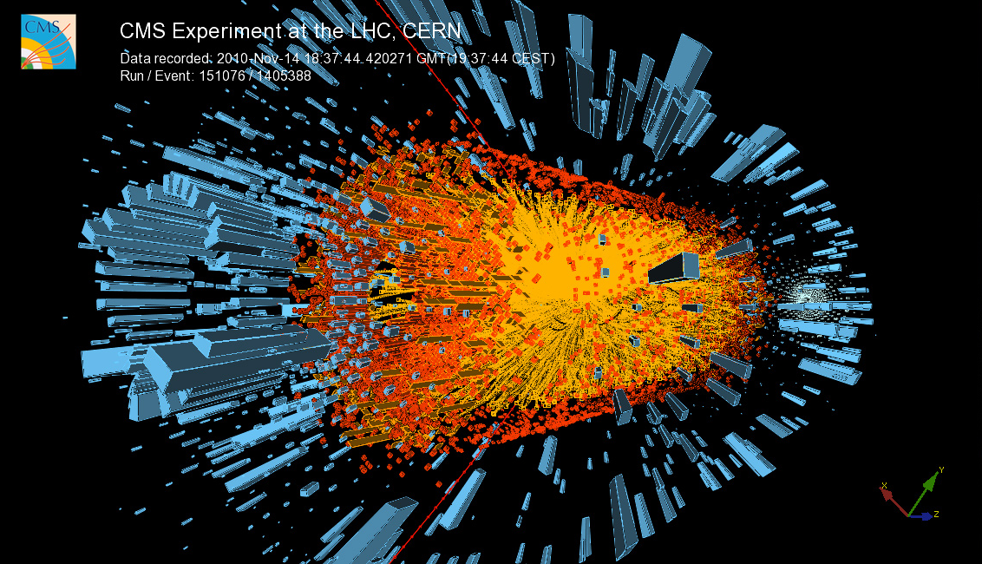
Event display in Pb+Pb Collisions
最初の衝突(08.11.2010)

Slide 13
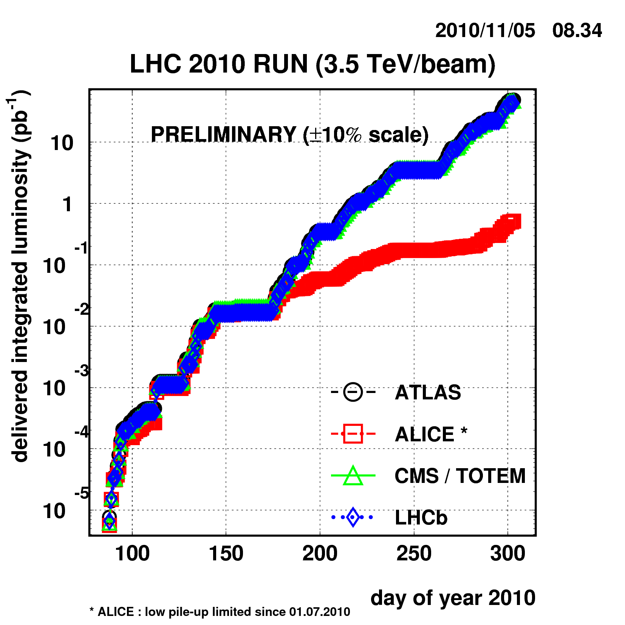
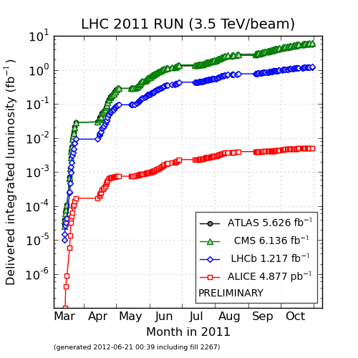
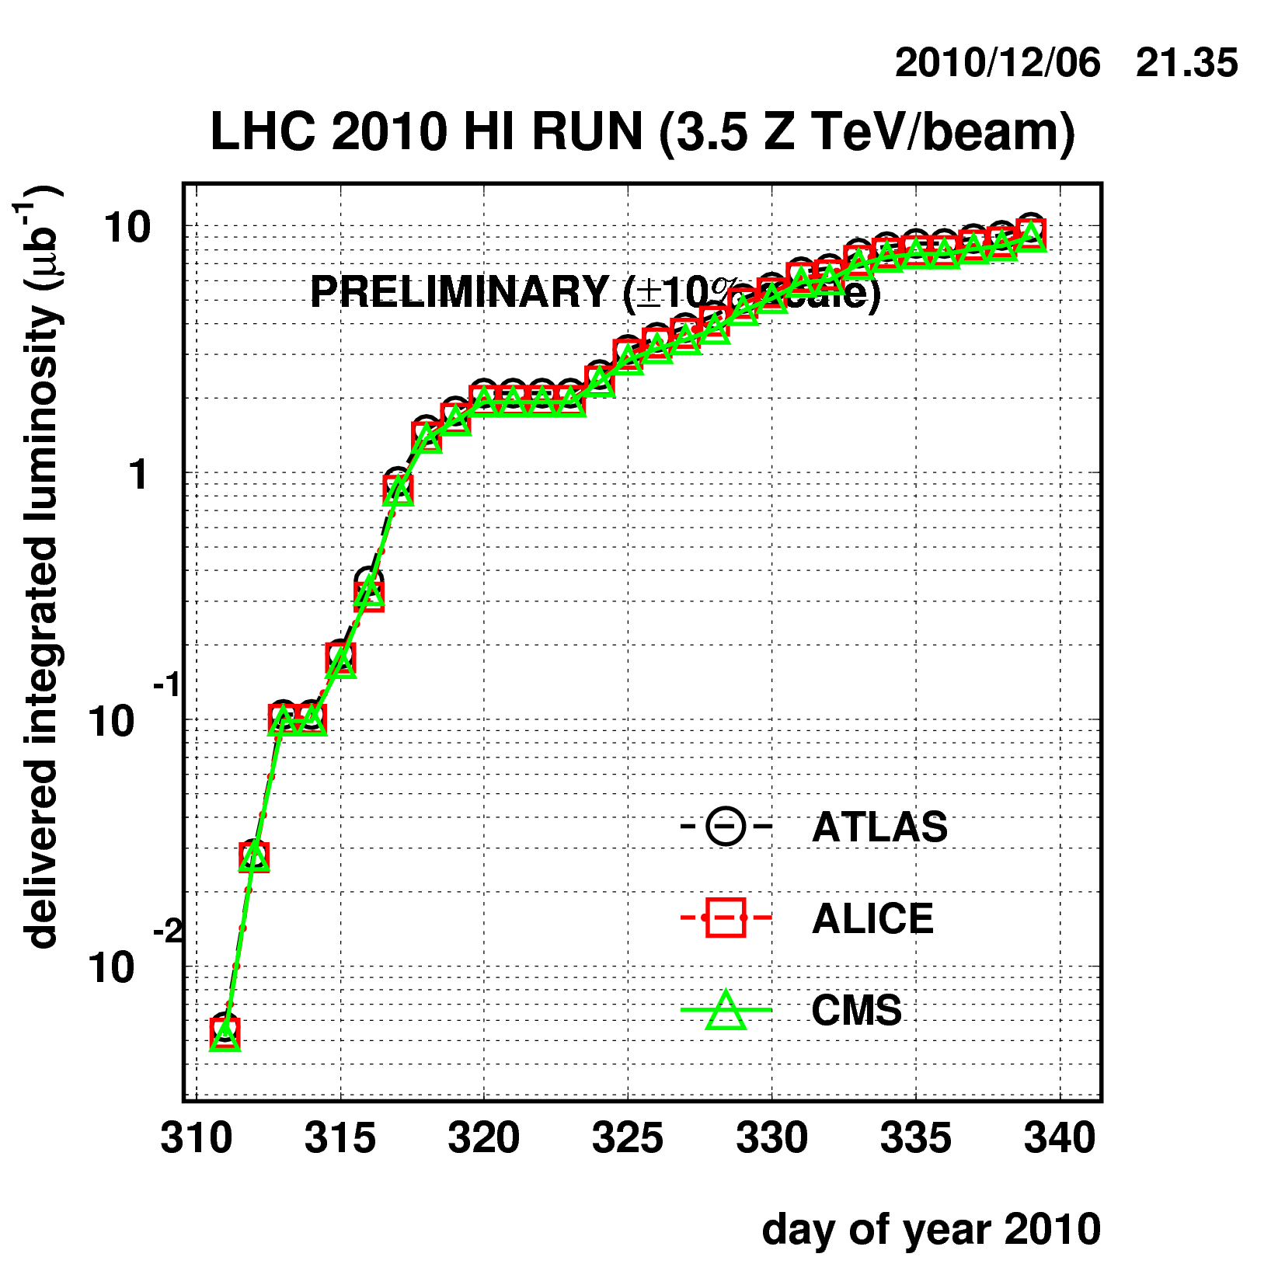
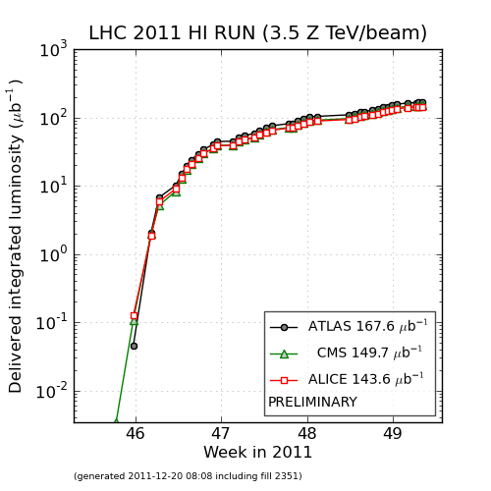
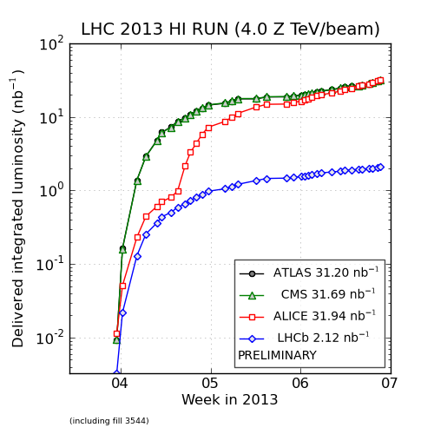
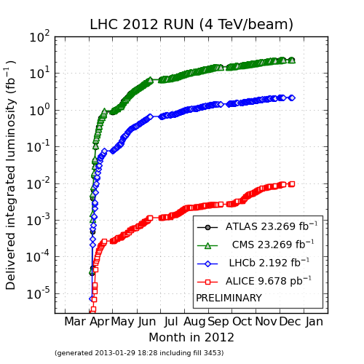
LHC運転状況と3年間のラン

Slide 14
前置き(RHICの成果)とLHCの成果(ALICE/CMS/ATLAS)

Slide 15
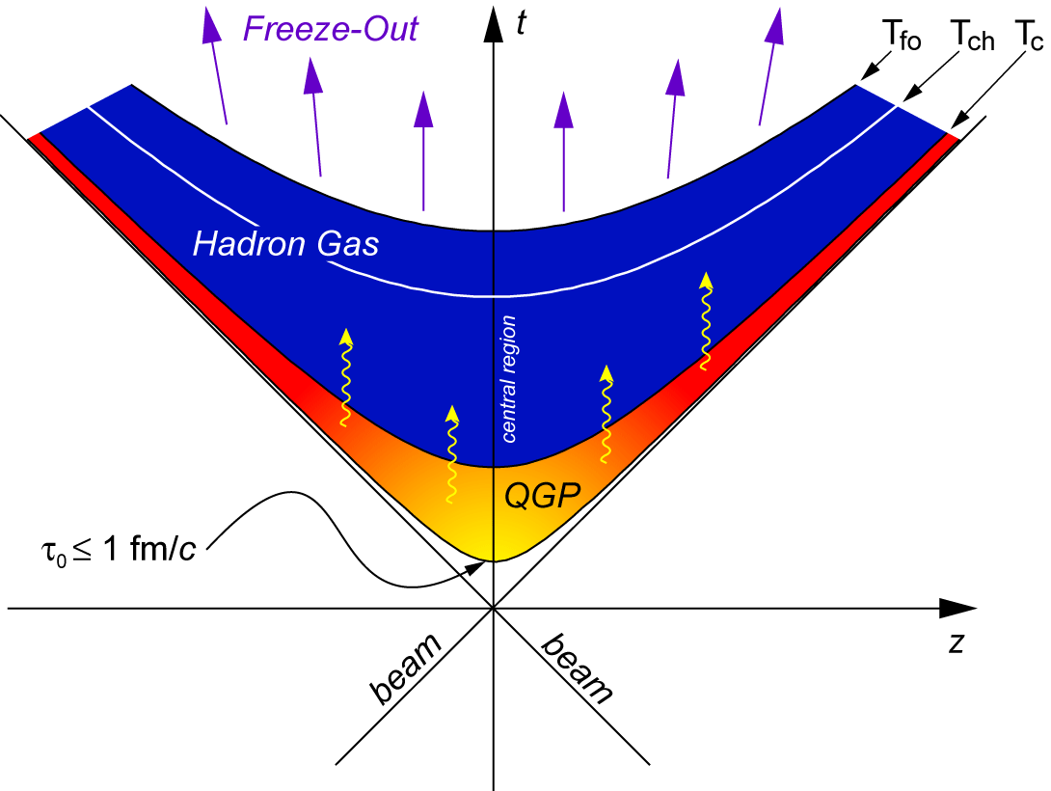
Space-time Evolution of HEHIC
Space-time Evolution
運動学的凍結(T=100MeV, t~20fm)
運動量分布が固定
(ハドロン間の弾性散乱の終焉)
化学的凍結(T=160MeV, t~10fm)
粒子数(比)が固定
(ハドロン間の非弾性散乱の終焉)
閉じ込め開始(T=160MeV, t~5fm)
(QGPからハドロン相への相転移は
高温・低密度領域ではクロスオーバー
中間密度では、１次相転移だと
考えられている)
クォークグルオンプラズマ(T>160MeV, t~1fm)
衝突初期〜熱平衡化
(高エネルギーでは、衝突初期は
原子核核子内のパートン分布。
衝突直後〜熱化は未理解。
HIにおいて最も難解な物理.
高強度ゲージ場＋不安定性＋熱化)
高エネルギー重イオンの物理
クォークグルオンプラズマの物性
初期状態。原子核内核子のパートン分布(グルオン飽和)の物理
熱化機構。高強度カラー場、非平衡QCDのダイナミクス

Slide 16
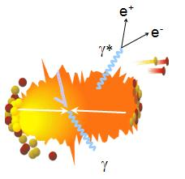
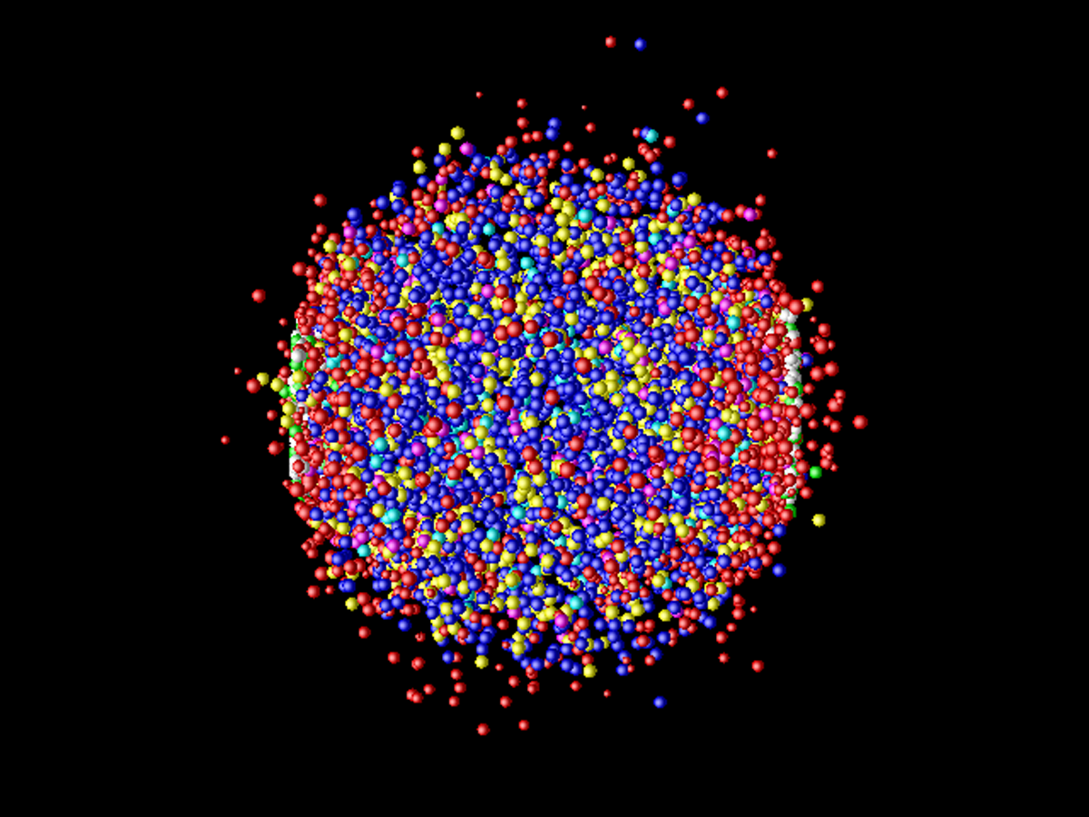
QGPを見るツール
電磁プローブ(光子、レプトン)
QGPの透過的なプローブ
熱的光子、電子対
系の温度、自由度
系の時空発展の情報
ハード光子
衝突初期のq+g散乱
核子核子衝突数
のスケーリング
ソフトな粒子(Low pT hadrons)
QGP中の構成パートンが種
時空発展の結果
系の集団運動(フロー)
運動学的・化学的凍結
エネルギー密度
系の大きさ
重クォーク・クォーコニウム
衝突初期のハード過程
QGPでは“不純物“
系の輸送特性
QGPの遮蔽長
温度
ハード過程
（high pT hadrons and jets）
衝突初期のパートン間の
ハード散乱が種
QGPとのカラー相互作用
パートン密度、輸送係数
φ, ω, ρ, ee/μμ pairs
質量変化の測定
真空構造、カイラル対称性の回復のヒント

Slide 17
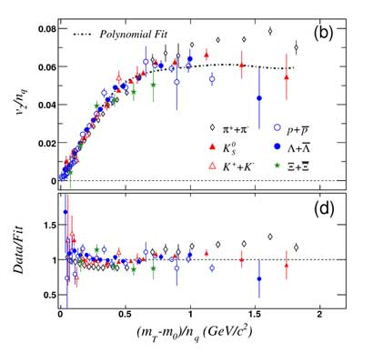
主なRHICの成果
大きな楕円フローの発見とsQGPの発見
構成クォーク数のscaling (s-quarkも含む)
(粘性)流体計算による記述
時空発展を記述するツール
物性研究への足がかり

Slide 18
主なRHICの成果
初期条件(CGC, Glauber)とη/s
初期条件次第で異なるη/s。衝突初期条件の重要性
Glauber
Glauber

Slide 19
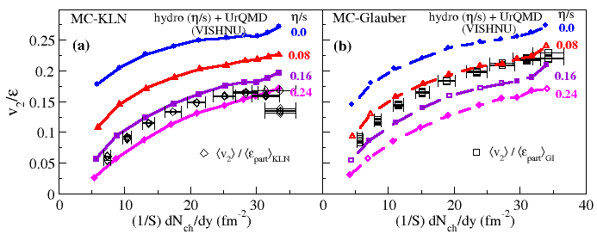
主なRHICの成果
初期条件(CGC, Glauber)とη/s
初期条件次第で異なるη/s。衝突初期条件の重要性
H. Song, S. Bass, U. Heinz, T. Hirano, and C. Shen, PRL2011
MC-KLN
MC-Glauber

Slide 20
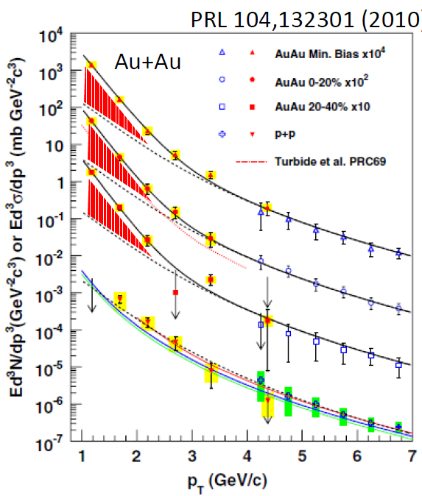
主なRHICの成果
低運動量(仮想)光子の測定
余剰成分=熱的光子
T_{slope}=220 +- 20MeV > T_{c}
初期温度と初期時間の制限
τ₀~0.1-0.6fm/c, T₀=300-600MeV
大きなv2はパズル
ε_{p}(運動量異方性)の飽和: 3~6fm/c [TECHQM]
PRL. 109,
122302 (2012)

Slide 21
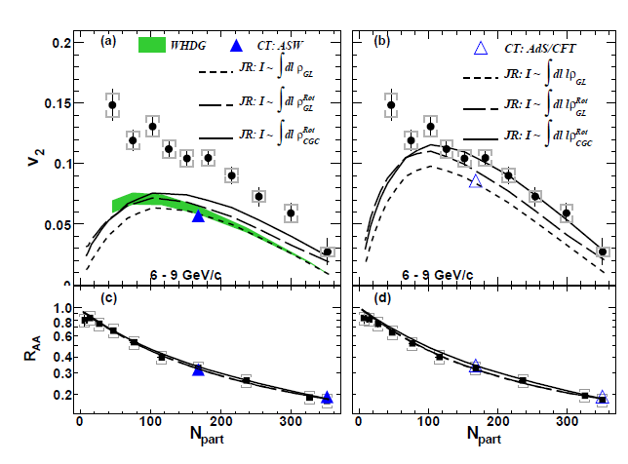
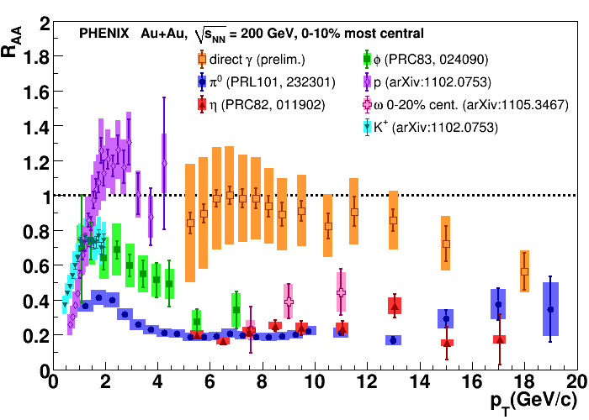
主なRHICの成果
ジェットクエンチングの発見
大きなp_{T}領域で、R_{AA} < 1
d+Au衝突や直接光子では見られない、終状態による効果
グルーオン放出によるエネルギー損失
dN_{g}/dy ~ 600-1000, qhat=6~24 GeV²/fm
Path length依存性 (v₂)
L²(pQCD)よりもL³(AdS/CFT)
の方がよく記述できる
R_{AA} = (d²N/dydp_{t})_{AA}/<N_{col}>(d²N/dydp_{t})_{pp}

Slide 22
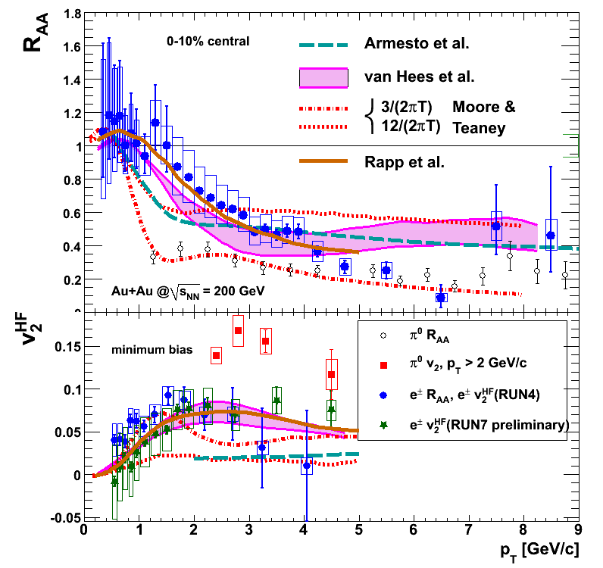
主なRHICの成果
重クォークのエネルギー損失
衝突過程によるエネルギー損失
QGP中のでブラウン運動
輸送係数→強結合に近い
Akamatsu PRC, 79. 054907, 2009
PHENIX, Phys. Rev. Lett. 98, 172301 (2007)
D_{HQ} x 2 πT ~ 4-6
D_{HQ} ~ 6 x η/(ε+p) = 6 x η/Ts
η/s ~ (4/3 – 2)/4π ~ 0.1
強結合を示唆
Relaxation time(1/Γ): ~ 5 (15) fm/c for c(b) quarks (cf. τ_{QGP}~5-10fm/c)
charm (and bottom) interacts in the medium strongly.

Slide 23



主なRHICの成果
d+Au衝突における前方方向(η>3)の粒子生成抑制
Rapidity依存性(y~3 → x=10⁻³~10⁻⁴)、中心衝突度依存性
モノジェットの観測
グルーオン飽和と無矛盾
τ_{cross}=0.13 fm/c
2 GeV at y=3 →τ_{prod} =0.01 fm/c

Slide 24
主なRHICの成果
他にも…
Di-electron
低質量領域に超過収量. PHENIXとSTARで異なる超過分
Huge enhancement in low mass dielectrons in PHENIX
Moderate enhancement in STAR
consistent with cocktail with in-medium ρ(broadening)
J/ψの収量抑制
Stronger suppression of J/ψ at forward-y (than at mid-y)
始状態効果: 原子核効果が前方で大きい(CGC)?
週状態効果： J/ψの再結合が中央rapidityで大きい?
v₂(π⁻) > v₂(π⁺) vs. (N⁺-N⁻)/(N⁺+N⁻)
Chiral Magnetic Effect + Chiral Separation Effect
Higher order flow
Ridge
Jet reconstruction, jet-hadron correlation (path length)
etc (Cu+Au, U+U)

Slide 25
課題とRHIC/LHCへの期待
初期条件の制限
RHIC-LHCの広範な運動学領域と系統的な検証
mapping large (x, Q²) space
x at RHIC forward (y=3) ~ x at LHC mid-rapidity (y~0)
v_{n}(n>2), e-by-e v_{n}, fluctuation, event plane correlationの測定
RHICとLHCのQGP物質の性質比較
LHC: hotter-longer-larger QGP、物性量 vs. Tの期待
LHCではhard cross-sectionが非常に大きい
MPI, ジェット, heavy flavor測定: disturbance of QGP, length scale/Q² evolution, thermalization of c/b quark?
クォーコニウム(特にΥ): length scale
衝突直後の電磁場、縦方向カラー場、熱化前の動力学
電子対、Ridge現象、長距離相関(大アクセプタンス in η)
QGP in high multiplicity events in p-p and p-Pb
物性量の高精度化
新たな軸 (event-by-eventの物理, jet tagging, hard photo,,,)

Slide 26

LHC vs. RHIC (global event properties)
dN/dη, dEt/dη
Bjorken energy密度: ετ=16 GeV/fm²c (>>5.4 GeV/fm²c at RHIC)
<m_{t}>=<dEt/dη>/<dN/dη> = 1 GeV (LHC), 0.85 GeV (RHIC)
τ₀ ~ 1/<mt> ~ 0.2fm/c (LHC), 0.24 fm/c (RHIC)
ε=80 GeVfm³(LHC), 20 GeV/fm³ (RHIC) → (T_{LHC}/T_{RHIC}) ~ 1.4

Slide 27
pT spectra, radial flow
大きなRadial flow
β = 0.66 > 0.6 (RHIC)

Slide 28
Baryon/Meson ratio
RHICよりも大きなB/M(Λ/K⁰_{S})、高いpTまで延びている
(p_{T}^{max})_{LHC}/(p_{T}^{max})_{RHIC}=1.1-1.3
Radial flowの影響
STARの結果はfeed down correction
がなされていない (30-40% from Λ)

Slide 29
Net charge fluctuation
Charge carrier (quarks or hadrons)?
E-by-e net charge fluctuation
Decrease vs. centrality and collision
energy
Measured ALICE data in between
HRG and QGP
D
D

Slide 30
Balance function
q-qbar creation time in rapidity
Ordering with energy:
Narrower Δy an Δφ at LHC
Larger radial flow (Δφ focusing)
More duration time of QGP
Modulation of Δφ w.r.p EP (Y. Hori)

Slide 31


Flow measurements
v₂だけでなく、Higher order v_{n} の新測定
+ Fluctuation, event-by-event v_{n},
+ Event plane correlation
衝突初期の更なる制限. η/sの精密化
Fourier series: dN/dφ = 1 + 2 v₁ cos(φ) + 2 v₂ cos(2φ) + 2 v₃ cos(3φ) +…
Elliptic, v₂
Triangular, v₃

Slide 32




Flow measurements
Higher order v_{n}, event-by-event v_{n}
初期ジオメトリーの揺らぎ(ε_{n}(空間非等方性))＋流体膨張
Nucleon or parton fluctuation? (IP-Glauber, IP-Sat/Glasma)
初期ジオメトリーの名残(ε_{n}(τ=0)) とε_{n}(τ) → η/s (x1/T) (dumping)

Slide 33
Flow measurements: v₂
Inclusive charged hadron v₂
RHICと同程度
PID(粒子種毎) v₂
NCQ scalingの破れ。Radial flow。
charged hadron v₂の一致は偶然 (または LHCで大きなη/s)

Slide 34
Flow measurements: v₂
Inclusive charged hadron v₂
RHICと同程度
PID(粒子種毎) v₂
NCQ scalingの破れ。Radial flow。
charged hadron v₂の一致は偶然 (または LHCで大きなη/s)

Slide 35
v₂ vs. dN_{ch}/dy
Knudsen number (クヌーセン数)
RHIC: (v2/ε)_{ideal}= 0.3 +- 0.02
K₀ = 0.7, c_{s}*σ = 2.4 mb, n=4fm⁻³
→ η/s ~ 2 /4π
arXiv:0704.3553v2
LHC: (v2/ε)_{ideal}= 0.5 ??? (my assumption)
K₀ = 0.7, c_{s}*σ = 0.5 mb, n=8fm⁻³
→ η/s ~ 4 /4π

Slide 36

Flow measurements: Higher order flow
Higher moment v_{n}(EP), 大きなv_{n}の発見
大きなnほど、大きなviscosity correction
v₂以外は(大きく)中心衝突度には依存しない
Ordering: v₃>v₄>v₅>v₆
ε₃>ε₄>ε₅>ε₆ とviscous correction
B. Schenke, QM2012

Slide 37



v_{n}と角度相関
v₃のmass ordering
ε₃＋”流体膨張”の証拠.
2粒子(Δφ, Δη)相関
大きなrapidity gapでの相関は
v_{n}の重ね合わせで記述出来る
v₃ for π/K/p
mass dependence typical for hydro !
v₃
v₂
v₄
37

Slide 38
v_{n} spectrum
v_{n} spectrum encodes:
Quantum fluctuations in the initial state
Dumping by viscous effects, propagation in matter
ALICE QM2012

Slide 39

流体計算との比較
様々な計算
T. Hirano, ATHIC2012

Slide 40

流体計算との比較、η/s
Initialization model
Fluctuation of nucleon-position (MC-KLN, MC-Glauber)
T. Hirano & Y. Nara, Phys. Rev. C 79 064904 (2009)
VISHNU hybrid model
Fluctuation of color-charge (IP-Saturated Glasma)
B. Schenke et al., arXiv:1202.6646; 1206.6805 [nucl-th]
C. Gale, et al., arXiv: 1210.5144, 1209.5330 [nucl-th].
B. Muller & A. Schafer, arXiv:1111.3347 [hep-ph]
S. Moreland, Z. Qiu and U. Heinz, arXiv:1210.5508
Fluctuation of gluon multiplicities (MCrcBK)
A. Dumitru and Y. Nara, Phys. Rev. C 85, (2012) 03490,
A. Dumitru, arXiv:1210.7864 [hep-ph].
From H. Song, QM2012
Monte Carlo
Glauber
r~√σ_{ΝΝ}/π~1fm
Monte Carlo
KLN
r~√σ_{ΝΝ}/π~1fm
IP-Saturation Model
r~Q_{s}⁻¹~0.1fm

Slide 41


v₂と流体計算
Assuming const.
RHIC vs. LHC
MC-KLN → η/s=0.16 at RHIC, η/s=0.2-0.24 at LHC
τ₀=0.9fm/c(η/s=0.16), 1.05(η/s=0.2), 1.2(η/s=0.24)
Need larger τ₀ for larger η/s to compensate larger radial expansion from share viscous pressure tensor π^{μυ}
charged hadron v2
Song, Bass & Heinz, PRC 2011

Slide 42



v_{n}と流体計算
Gale, Jeon, Schenke, Tribedy, Venugopalan, arXiv:1209.6330
RHIC vs. LHC
v_{n}と流体計算の比較
IP-Saturation model
RHIC: η/s=0.12
LHC: η/s=0.2

Slide 43



Ultra-Central collisions and v_{n}
0-0.2% central collisions
No difference in ε₂-ε₆
Powerful test of η/s (viscous correction)
η/s = 0.2 (MC-KLN, Glauber)
CMS-PAS HIN-12-011
CMS-PAS HIN-12-011
v₂
v₃
v₄
v₅
v₆
v₇
Calculation by Heinz et al.
Calculation by Luzum et al.

Slide 44



η/s(T)
v₂ vs. η/s(T) for RHIC vs. LHC
大きなsensitivityはない
より高精度な測定が必要

Slide 45


η/s(T)
v₂ vs. η/s(T) for RHIC vs. LHC
RHICではhadronicでのη/s?
LHCでhadronic + QGP中のη/s?
H. Niemi et al. arXiv: 1112.4081

Slide 46
Event-by-event v_{n}
Further detailed check of Initial state and η/s
Comparison with e-by-e ε_{n} vs. v_{n}
Central: MC-KLN, Peripheral: MC-Glauber
Central~Mid-central: IP-Glasma (0-5%, 20-25%)
E-by-e v3, v4 → KLN/Glauberのe-by-e ε_{n}
でよく合う
C. Gale, et all. arXiv:1209.6330
ATLAS, arXiv:1305.2942

Slide 47

Higher Order Event Plane Correlations
Qiu & Heinz, arXiv:1208.1200[nucl-th]
EXP. data:[ATLAS Collaboration], CERN preprint ATLAS-CONF-2012-049
Pure e-b-e viscous hydro simulations :
qualitatively reproduce the measured event plane correlations

Slide 48

Particle correlation in p-p
Ridge in high multiplicity p-p collisions
long range correlation (LRC)
起源: 初期に作られるcorrelation
= longitudinal strong color field
Amplitude of associated yield and
Δφ (correlation width) depends on
collective flow (radial flow).
LRC in p-p is only from strong color field (no radial flow)
LRC in Pb-Pb is from strong color field + radial flow
arXiv:1201.2658
Vr=0.3
Vr=0.25
Vr=0.2
Vr=0.1
Vr=0

Slide 49
Particle correlation in p-Pb
Observation of ridge in high multiplicity p-Pb collisions (N_{trk}>110 same as in p-p)
initial state effects arising from the correlations of gluons
How about collectivity in p-Pb?
If there is, what is the seed of flow?
Mini-jets (origin of high multiplicity) or Glasma?

Slide 50
Particle correlation in p-Pb
Q_{s}²(proton) ~ x^{-0.2} ~ 1.3 GeV²
Q_{s}²(nuclei) ~ N_{part}^{1/3}*x^{-0.3}
Ridge in high multiplicity in p-Pb
Quantum fluctuation + Flow in p-Pb(?)
Ridge yield : Pb-Pb > p-Pb > p-p → ordering of Q_{s}(Pb/p)?
CMS pA workshop
at MIT 2013

Slide 51
Particle correlation in p-Pb
Observation of double ridge structure
0-20% - 60-100% (jet contributionを除く)

Slide 52
Particle correlation in p-Pb
ALICE double ridge
= Glasma graphs
Double Ridge(near side)の起源
Color flux tube
(ex) 2gluon production from
2 gluon ladders (power counting)
Enhance near-side correlation
by correlations induced by
color fluctuations
How about 3 gluon production??
Origin of v3 in p-Pb?
arXiv:1009.5295
BFKL Mini-jet
Glasma
graphs
ATLAS = Glasma graphs
+ mini-jets

Slide 53
Particle correlation in p-Pb
v₂ in p-Pb
v₂: Pb-Pbと同じ傾向 (magnitudeはp-Pbの方が小さい)
この領域(p-Pb, Pb-Pb centrality >50%)
では、ε₂の減少に対し、v₂は大きくなる
Large viscous correction (L~λ)
p-Pbも同じ? Or Glasma graphの
ようなinitialなfluctuationのみ？

Slide 54
Particle correlation in p-Pb
v₃ in p-Pb
v₃: Pb-Pbと同じ
Viscous correction for Pb-Pb. (ε₃(Pb-Pb) > ε₃(p-Pb))
initial quantum fluctuation+流体膨張の可能性
Grasma graphのみはv₃には寄与しないはず.. でも3gluon生成過程とその相関は？
Ex) CGC/Glauber initial + e-by-e viscous hydro. (arXiv:1304.3403)
IP-Glasma under-predicts measured v2/v3
CMS pA workshop 2013

Slide 55
“Fat” Proton
Proton = complex and fluctuating quantum system
Stringy proton : surplus of soft gluons
Cloudy proton : surplus of quarks and anti-quarks
+ intrinsic fluctuation of color charge (glasma)?
B. Muller pA workship at MIT (2013)

Slide 56
Identified particle spectra in p-Pb
p-Pbの粒子多重度依存性, Blast wave fit
Slopeのmass dependence: T = T₀ + m*<β>²
<β>² from data = 0.4, T₀=0.22 (cf: <β>²=0.26, T₀=0.17 in Au+Au)
No such trend in MC models (HIJING, AMPT)
Similar trend of (β, T_{fo}) in p-Pb as in Pb-Pb
CMS, pA workshop in MIT (2013)

Slide 57
Particle ratio (baryon/meson) in p-Pb
Λ/K⁰_{S}
Clear evolution of Λ/K⁰_{S} with increasing centrality
Ratio in p-Pb (0-5%) ~ Pb-Pb(50-80%)

Slide 58
High p_{T} suppression/Jet quenching
Parton energy loss in the medium
Parton(E) = Parton(E’=E-ΔE) + soft particle(ΔE)
Energy loss depends on:
qhat = opacity
medium properties
qhat = m_{D}²/λ = m_{D}²*ρ*σ
L = path length
L¹ = elastic,
L²=radiative,
L³=AdS/CFT
C_{q} (Casimier)
f(E): energy dependence (ln(E), ~const)
f(m):quark mass dependence
radiative or collisional
dead cone effect for heavy quarks
jet quenching measures
‘stopping power' of QGP
ΔE ~ f(m) x c_{q} x q x L^{n} x f(E)
^
m_{D} ~ gT ~ 1 GeV (T=0.4 GeV, α_{s}=0.5)
= 16/π²*ζ(3)*T³ ~ 15 fm⁻³
σ_{gg}(T) ~ 9πα_{s}⁴/(2m_{D}²) ~ 9mb
qhat ~ 2 GeV²/fm
λg ~ 0.5fm, λq ~ 9/4*λ_{g} ~ 1fm << R_{sys}
q
q
q
q

Slide 59

R_{AA} of PID hadron at high pT
High p_{T}ではπ/K/protonの違いはない
RHICと同程度の抑制 (cf. RHIC: q-jets, LHC: g-jets dominant)
High p_{T}でR_{AA}が増加
LPM, Punch through
Spectrum形状の変化(特にp-p)
(power low-hard scattering成分)

Slide 60


QGP stopping power
δp_{T}
R_{AA} depends on p-p spectrum (steepness → δp_{T} instead of R_{AA}
(δp_{T}/p_{T})_{LHC}~0.3. (δp_{T})_{LHC} ~ 1.3(δp_{T})_{RHIC …}If δp_{T} ∝ qhat ∝ 1/mfp,
(dN_{ch}/dy)_{LHC} ~ 2.2(dN_{ch}/dy)_{RHIC} → σ_{LHC} ~ 0.6σ_{RHIC}
Less opaque (σ) at LHC
PHENIX, QM2012

Slide 61
Comparison with model calculations
RHIC: L³ dependence → AdS/CFT > pQCD
LHC : pQCD > AdS/CFT
More transparent than the extrapolation from RHIC
Smaller coupling to medium: α_{s}=0.3(RHIC) →0.26(LHC) → larger η/s
Jet energy ←→ different length scale of medium interaction
high E: scatter from point-like color charge (pQCD)
low E: scatter from coherent field (AdS/CFT) or quasi-particle(λ_{D})
a=1/3 “pQCD”
α=0.26
α=0.3

Slide 62
High p_{T} particle v₂
High pt particle v₂
p_{T}>20GeVでもv₂は有限の値。
Path length依存性
L²の依存性でよく記述される
RHICではL³
Pb
Pb

Slide 63



Jet measurements
Direct measurement of Jet quenching
(cf.) leading fragments at RHIC
Alice
How much energy is lost?
Where is it lost/where lost energy goes?
102 GeV
47 GeV
Energy flow in η−φ plane
CMS
Δφ
Δη
Atlas

Slide 64


Jet R_{AA}
Jet R_{AA} ~ 0.5 (similar to charged hadron R_{AA})

Slide 65
Di-jet measurement
Di-jet asymmetry
Jet energy asymmetry (A_{j})のMCとのずれ
中心衝突で顕著
高いjet p_{T}になるほど、MC(= embedding PYTHIA dijets into HYDJET)と一致
Jetのpunch through?

Slide 66
Di-jet measurement
p_{T} balance (p_{T}>100)
<p_{T2}/p_{T1}>_{data}-<p_{T2}/p_{T1}>_{MC}= 0.1 (0-20%) (δp_{T}/p_{T}~0.3 in low pT)
Less jet energy dependence
200 (300) GeV Jet → ΔE = 20 (30) GeV

Slide 67
Di-jet measurement
Δφ₁₂
E → E’ + ΔE
Di-jetの角度相関
Remain back-to-back
Radiated energy appears in wide angle w.r.t jet-axis

Slide 68

Di-jet measurement
FFの変貌
大きなξ(小さなz=p_{Ta}/p_{Tj})で収量の増大
Lost energy → particle production in low pT and wide angle
Pb
Pb
Pb
Pb

Slide 69


Mass dependence (c/b quark energy loss)
D meson & single-e/μ(ALICE), J/ψ from B (CMS)
Not conclusive but: ΔE(u,d,s) < ΔE(c) < ΔE(b)?
BAMPS/POWLANG: HQ transport with collisional energy loss
RAPP: HQ transport with in-medium resonance scattering
and coalescence
Charm Mesons
(π⁺ + π⁻) R_{AA}
b quark dominant
B Meson
D

Slide 70

Mass dependence (c/b quark energy loss)
D meson & single-e/μ(ALICE), J/ψ from B (CMS)
Not conclusive but: ΔE(u,d,s) < ΔE(c) < ΔE(b)?
BAMPS/POWLANG: HQ transport with collisional energy loss
RAPP: HQ transport with in-medium resonance scattering
and coalescence

Slide 71
Heavy quarks (RHIC vs. LHC - I)
Electrons from heavy quarks (c/b)
Caveat: c/b contribution depends on collision energy
More b in higher p_{T} → thermalization of b quark at LHC?
(τ_{b}~15fm/c > τ_{QGP} ~ 10fm/c at RHIC.)

Slide 72


Heavy quarks (RHIC vs. LHC - II)
Suppression starts from 2-3 GeV at RHIC
Coalescence (blast wave from QGP pushed charm to high pT) ←→ fragmentation (higher pT)
At LHC, D is still suppressed at 1-2 GeV…
Coalescence (shift to higher p_{T} due to larger radial flow) at LHC?
Stronger HQ energy loss (shift to much lower p_{T})?

Slide 73


J/ψ suppression
QGPのガリレオ温度計
溶解温度は未だ決定的でない, J/ψ: 1.2-2T_{c}
ccbar→J/ψ(再結合)の可能性
medium中 or phase boundary
原子核効果の重要性(shadowing, breakup)
anti-shadowing
arXiv:0802.0139
shadowing

Slide 74


J/ψ suppression at RHIC
RHICの結果
中央ラピディティで再結合が顕著
前方で強い原子核効果
+sequential melting
|y|<0.35
1.2<|y|<2.2
PRL.98, 232301 (2007)
arXiv:0801.0220

Slide 75



J/ψ suppression at LHC
J/Ψ R_{AA}:p_{T} dependence
LHCの結果
RHICより収量増大
低運動量で収量大
再結合を示唆
melting
regeneration
central y≈0
forward y≈3

Slide 76


Υ suppression at LHC
CMSより
Sequential melting

Slide 77
Low p_{T} Photon
外部変換光子測定(γ->ee) in ALICE
低運動量光子測定に有利
Material budget: 11% +- 0.5%
少ない系統誤差で理解
超過収量の測定: T=304 +- 50 MeV

Slide 78
Low p_{T} Photon v2
大きなv2を測定
流体模型をベースにした計算
Thermal Photon v2より
も大きなv2を測定
新しい寄与が必要？
衝突初期の電磁場
クォークのシンクロトロン放射
Quark distribution? (K. Tuchin)
Conformal anomaly
arXiv.1208.5502, arXiv.1305.7224
ハドロン相からPhoton
これまでも見積もりが甘い?
クロスオーバー領域からの
光子(ハドロン励起状態)
EOS? Build up ε_{p} more quickly?

Slide 79
Summary of LHC Run-I
LHC: hotter-longer-larger QGP
Net charge fluctuation, balance function
More interior of QGP (partonic degree in global observables)
Charge creation at later stage
Flow measurement:
v_{n} measurement, event-by-event flow, EP correlation
Further constraint initial conditions and eta/s
Partonic fluctuation (color charge etc), x1.5 η/s (compared to RHIC)
Double ridge in p-Pb (high multiplicity)
Color flux tube (quantum correlation) + mini-jet → constraint to I.C of HIC
flow or non-flow → More will come!
High pT particle measurement
New regime of high pT particle production
Parton energy → length scale of parton-medium interaction
high pT (>20 GeV): pQCD >> AdS/CFT, less opaque (compared to extrapolation from RHIC) smaller coupling and large η/s
Flavor dependence, b-thermalization?
Quarkonia
Recombination for J/ψ, sequential suppression vs. binding energy
Photon
Large photon v2 at LHC (and RHIC) → puzzle

Slide 80
今後の展望(期待)

Slide 81
Shopping lists
Initial states
CGC, Glauber, Fluctuation(nucleon, color, # of gluon, length)
Many experimental developments
What is the role of “pre-equilibrium” dynamics?
How much purely initial state (ε_{n}(τ=τ₀)) is diluted?
Free streaming (weakly coupled) or strong correlated (anomalous viscosity)?
When momentum anisotropy start to be built up?
arXiv:1009.1847
ε_{n}(τ₀) vs.
Gaussian
smearing width in (x,y)
ε_{n}(τ₀)/ε_{n}(0) for
free streaming case

Slide 82
Shopping lists
arXiv:1102.1403
Initial states
What’s next?
Precious measurements of v_{n}
+ PID hadrons (flow), HQ+high pT (initial +flow)
prompt photons (only initial)
Correlation of <v_{n}(y₁)*v_{m}(y₂)> vs. EP correlation
EP correlation in p-A (and A-A)
Event-by-event un-triggered correlation
Event-by-event v_{n} and β_{n} (radial flow w.r.t ε_{n})
Understanding Pb-Pb/p-Pb/p-p ridge/v_{n}.
Glasma fluctuation + event-by-event flow?
Origin of flow in pA: color flux tube or mini-jets?
Q_{s}(p) + Q_{s}(Pb) dependence (N_{part})
V_{n} and dumping by η/s, PIDed flow in Pb-Pb/p-Pb/p-p
R_{AA} in high multiplicity p-Pb
Extreme large radial flow, P/pi ratio event in p-Pb
Ridge associated yield and Δφ width (→I.C+length scale + radial flow)
R.P.G. Andrade
INT workshop
on Ridge, 2013

Slide 83
Shopping lists
Dynamics of pre-equilibrium
Strong EM field
Lifetime of EM field → electric conductivity of QGP
τ=R²*σ/4, σ=0.37fm⁻¹(T/T_{c})² (from lattice) → τ=2.2(T/T_{c})² fm/c
Chiral Magnetic wave
v₂(π⁻) – v₂(π⁺) → B(τ), STAR results (arXiv.1208.2537)
Lepton pairs & polarization
Energy loss (by synchrotron radiation) from extreme high pT quark jets vs. gluon-jets vs./(and, or) high p_{T} photons/Z/DY pairs
Glasma
Role for thermalization scenario? Entropy production? Time scale? Dilution of spatial/momentum anisotropy?
R_{AA} for extreme High p_{T} jets vs. high p_{T} photons/Z/DY pairs?
Long range correlation in A+A/p-A/p-p
Evolution w.r.t Q_{s}(N_{part})
with and without flow contribution vs. system size (A+A vs. p-p/p+A)
Associated yield, v_{n} correlation, PID dependence, HQ

Slide 84
Shopping lists
arXiv: 0901.4355
QGP Medium evolution
Time scale of dumping ε_{x} and
building up ε_{p}
EOS and η/s x 1/T vs. T
Precious determination of η/s,
length scale, electric/heat conductivity
Temperature dependence
Nature of QGP: Quasi-particle, purely partonic
Photon, Dileptons
Complementary measurements of
quark/gluon jets, γ-jets, HQ jets
qhat (=√(p_{T} transfer)²/λ)
Di-jet, jet-hadron, broadening
ehat (energy transfer to QGP medium)
Gamma-jets vs. jet cone and associated
particles (energy balance)
Ratio is sensitive to “medium
parton mass (mass of quasiparticles).”
arXiv:
1209.3328
massive
light

Slide 85
Shopping lists (need precious meas.)
Photon:
Understand source of large photon v₂ (another photon source from later stage or earlier stage? or issues for EOS?)
R_{AA}, v_{n}, HBT for hard photon, soft photon, virtual photon (BR)
Di-lepton:
M_{ll} → T : space-time evolution, T dependence of η/s, chiral symmetry
Differential measurements (pT, v_{n}, M_{ll,} polarization)
Heavy flavor
Thermalization of c and b. Transport properties. Charmed baryons (coalescence, freezeout)
R_{AA}, v_{n}, high p_{T} vs. fine centrality, correlation of HF
Jets
Systematic studies (wide Et range, event characterization w.r.t A_{j})
Gamma-jets, di-jets, heavy quark-jets (E scale vs. collisional loss)
Flow
v_{n} for centrality, PID, HQ, photon, lepton
E-by-e v_{n}, Correlation

Slide 86
Shopping lists
Event-by-eventの物理
今までの場合分け: Centrality, event plane (ψ_{n})
Multi-dimensional analysis
vs. Jet Et, Jet/hard photon multiplicity, jet-energy asymmetry
No jet, One jet Et=100 GeV vs. Two jets 50 GeV
Angular correlation
Event-by-event v_{n}(p_{T}, η) of hard vs. v_{n}(p_{T}, η) of soft (correlation), their correlation vs. n-th order radial flow β_{n}
Fluctuation and event-by-event β_{n} (→η/s, ζ/s) vs. v_{n}
Search for large β/v_{n} event
di-lepton (catch high M_{ee}/p_{T} event)
…
Always under consideration …

Slide 87

ALICE upgrade計画
LS1(2013-2015)
DCALの建設, TRDの建設、TPC(など)の読み出し高速化
ジェット・ハード光子の物理
Di-jet, pi0-jets (gluon jets), gamma-jet (quark jet)
ハードとソフト粒子の相関測定(失ったエネルギーの変貌)
Correlation between EMCal/D-CAL and TPC
重クォークや電子対の物理

Slide 88




ALICE upgrade計画
LS2(2018)
50kHz Pb-Pb MBでのデータ取得 (今の100倍)
最内層SPDの建設、TPCの高度化(MWPC->GEMへ, R&D by 東大)
MFTの建設(muon absorberの前のシリコンピクセル)
読み出しの高速化(トリガーレス or パイプライン化)
重クォークの物理、チャームバリオン、広運動量チャーム/ボトム
光子•電子対の物理 (仮想光子、偏極度、熱的電子対)
ミューオン対の物理(低質量、重クォーク、クォーコニア)、
ジェット、ハード-ソフト物理、heavy nuclei

Slide 89



ALICE upgrade計画
D⁰ DCA resolution (ITS upgrade)
D_{s}⁺ S/N, Siginificance
Λ_{c} signal significance
Λ_{c} /D⁰ signal significance
D⁰ v2

Slide 90
ALICE upgrade計画
Need to fight with:
Conversion/Dalitz
S/N (combinatorial)
Charm contributions
Charm yield
Correlation
Electron ID by TPC/TOF
High rate TPC required
BG rejection (conversion,
Dalitz, charm pairs)

Slide 91
重イオンと他分野
ストレンジネス
ハイパー核
Double hyper???
Λ-Λ短距離相関
ハドロン物理
Exotic hadronと閉じ込め機構
強相関物性系
早期熱化のヒント(光誘起現象), 強相関の起源(極低温フェルミガス系)
arXiv:1107.1302
A. Andronic et al

Slide 92
まとめ
LHC第一次運転が終了(2010-2013)
Full energyにむて改修中. 2015年に再開の予定
LHCでのQGP
Hotter – larger – longer lived QGP
初期の不定性や極初期のダイナミクスは確定していないがη/sはRHICよりも大きな値か. η/s(T)を反映?
Jetの測定(新しいpT領域): qhat->less opacity, 小さなcoupling, RHICとは違うlength scale
初期の揺らぎの重要性
p-p/p-Pb/Pb-Pbでのridgeの観測. soft QCDの重要性
今後の展望
初期条件の確定、熱化機構、物性の温度依存性
測定量の高精度化(v_{n}, PID, HQ, jets+X, lepton/photon, etc)、系統性(p-p/p-Pb/Pb-Pb + RHIC)
ALICEの次期計画, RHICの次期計画(sPHENIX)

Slide 93
backup

Slide 94
Fluctuation and Flow
native thoughts:
δv(τ) ~ δv(τ₀)*exp(-Γ_{s}*(τ-τ₀))
Γ_{s} = η/s * 1/T
Reynolds number
Re = L*v/Γ_{s}
Re ~ 20 for L= 6fm, v=0.2c, η/s = 1/4π, T=300MeV
Fluctuation of Reynolds number???
high T, large v
large Re → turbulence?
Instabilities,
Anomalous viscosity

Slide 95
LHC-ALICE実験
STARとPHENIXを併せた測定器群

Slide 96
Eccentricity RHIC vs. LHC
T. Hirano, et al. 1012.3955
e2

Slide 97



EM probes: Photons
Photon spectra
Pion spectra
K. Dusling, 0903
-Viscous hardening of PT-spectra is stronger for photons than hadrons
-However, earlier thermalization also leads to harder photon spectra (Dusling 0903)
-Photon spectra MAY HELP to constrain the 2-d range of QGP viscosity & thermalization time, together with other observables (V2 …)

Slide 98
EM probes: Photons
-Viscous hardening of PT-spectra is stronger for photons than hadrons
-However, earlier thermalization also leads to harder photon spectra (Dusling 0903)
-Photon spectra MAY HELP to constrain the 2-d range of QGP viscosity & thermalization time, together with other observables (V2 …)

Slide 99

CME
M. Hongo, HIC 4.27.2013

Slide 100
CME
τ=lifetime of B
Assuming constant B over time

Slide 101
Magnetic field
Magnetic field

Slide 102
Particle production and correlations
Initial fluctuation vs. hydro flow
Glasma contributions : AA > pA > pp (power counting)
More gluon ladders from p-p → A+A
K. Dusling, INT workshop, 2012

Slide 103
Particle production and correlations
Collimation in pT and phi
Built up by collective flow → Case for A+A
Build up by “intrinsic” correlation induced by color fluctuations
Case for p-p and p-Pb
F. Gelis, 2010
K. Dusling, INT workshop, 2012

Slide 104
Depends on medium density
In dilute medium
Independent processes: bremsstrahlung & scattering
Calculate probabilities and add them up
Independent radiations follow Bethe-Heitler
In dense medium
Mean free path is short: λ = σ/ρ
Formation time of radiated gluon: τ = ω/k_{T}²
Transverse momentum of radiated gluon: k_{T}²=nμ²
# of collisions n=L/λ, μ=typical p_{T} transfer in 1 scattering
λ,μ are properties of the medium, combine to qhat = √μ²/λ
Coherence in the dense medium!
Next scattering takes place faster than gluon formation
Add amplitudes for all multiple scatterings
In QCD this increases the energy loss!

Slide 105
v₂ and η/s at LHC and RHIC
Hydro model calculation (VISHNU)
RHICとLHCで同じη/sで何故v₂の大きさは違うのか？
Peripheralで顕著
(論文でも言及されて
いなかった気が…To be checked)
Possible solution
ε₂の違い (Q_{s}の違い)
Tの違い
ε_{n}のdumping η/s x 1/T
大きなTの方がε_{x}が早くdumpする
→ε_{p}への転化/成長が早い or
飽和した時のε_{p}が大きい
→ v_{n}が大きい(ということか…)
BES(RHIC)などで系統的にstudyする必要性. Tの測定の重要性
Song, Bass & Heinz, PRC 2011

